Slide 1

Notes:
Slide 01

Slide 2
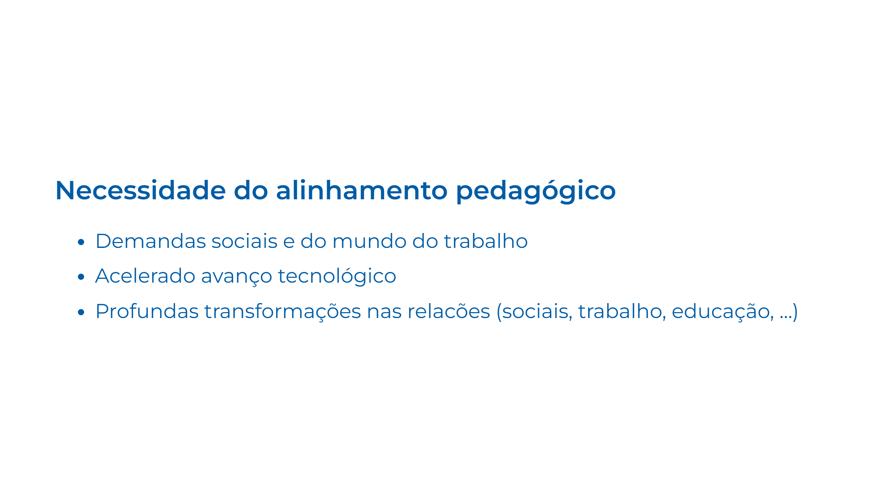
Notes:
Slide 02

Slide 3
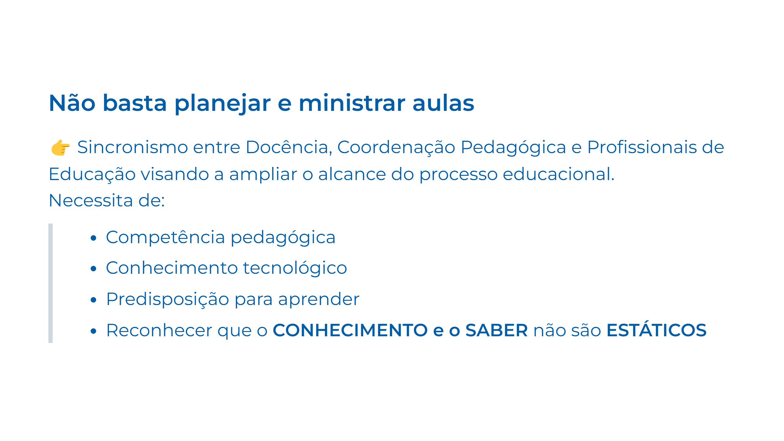
Notes:
Slide 03

Slide 4
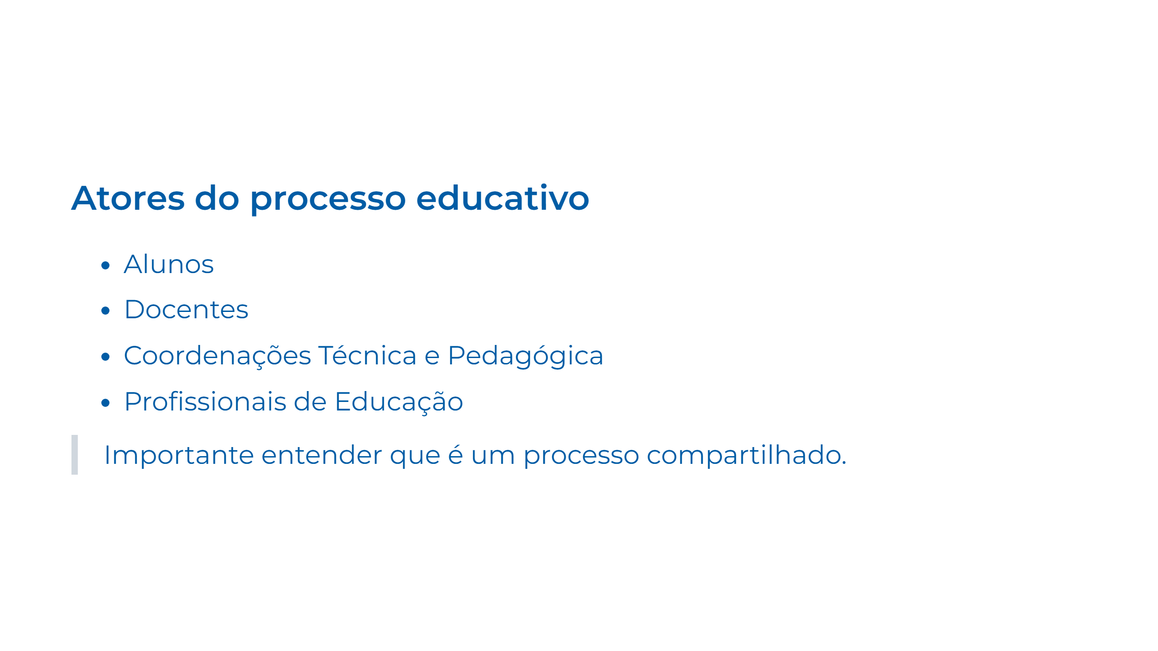
Notes:
Slide 04

Slide 5

Notes:
Slide 05

Slide 6
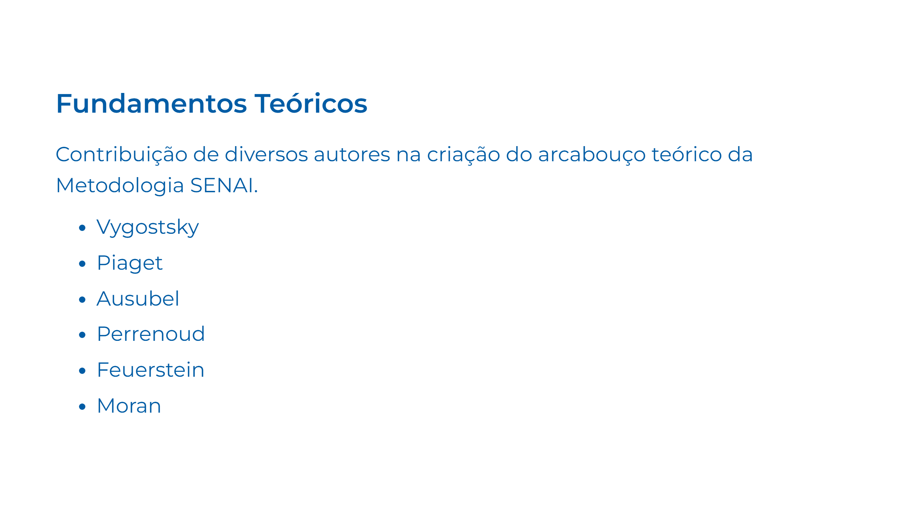
Notes:
Slide 06

Slide 7
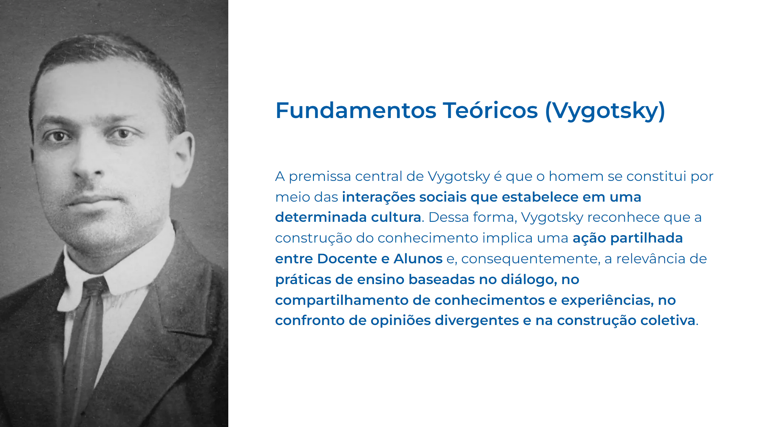
Notes:
Slide 07

Slide 8
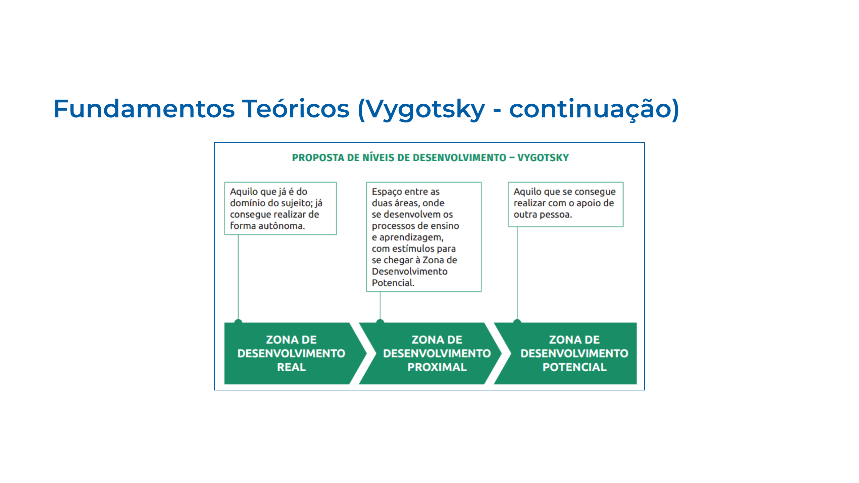
Notes:
Slide 08

Slide 9
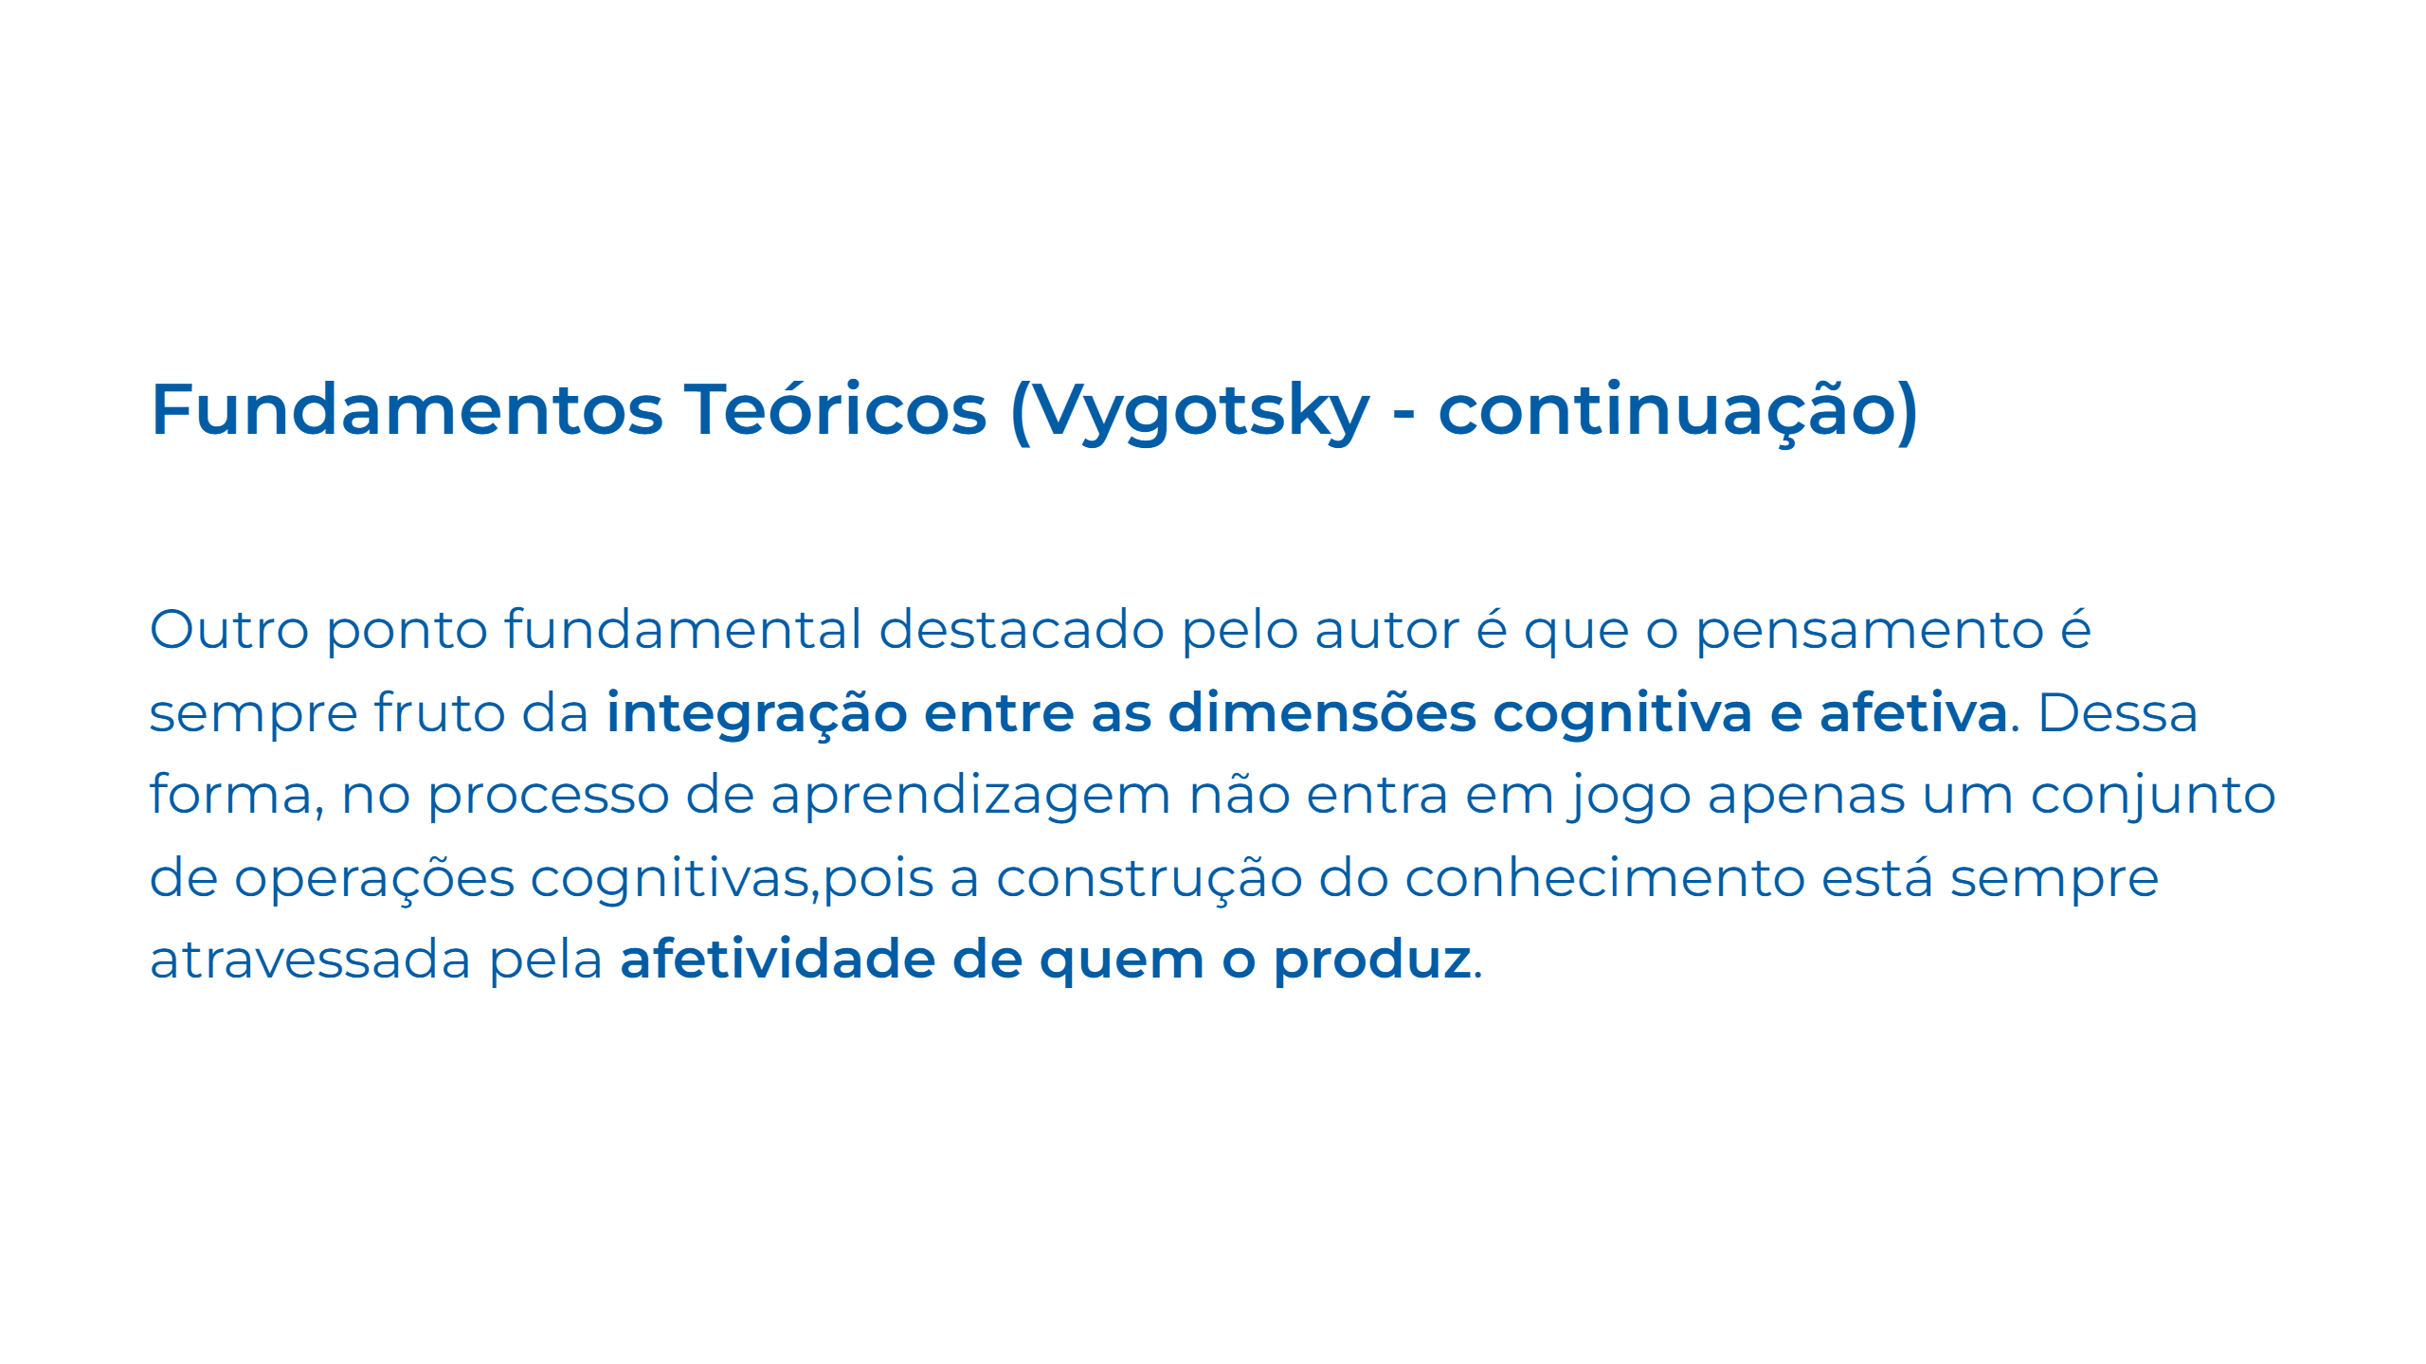
Notes:
Slide 09

Slide 10
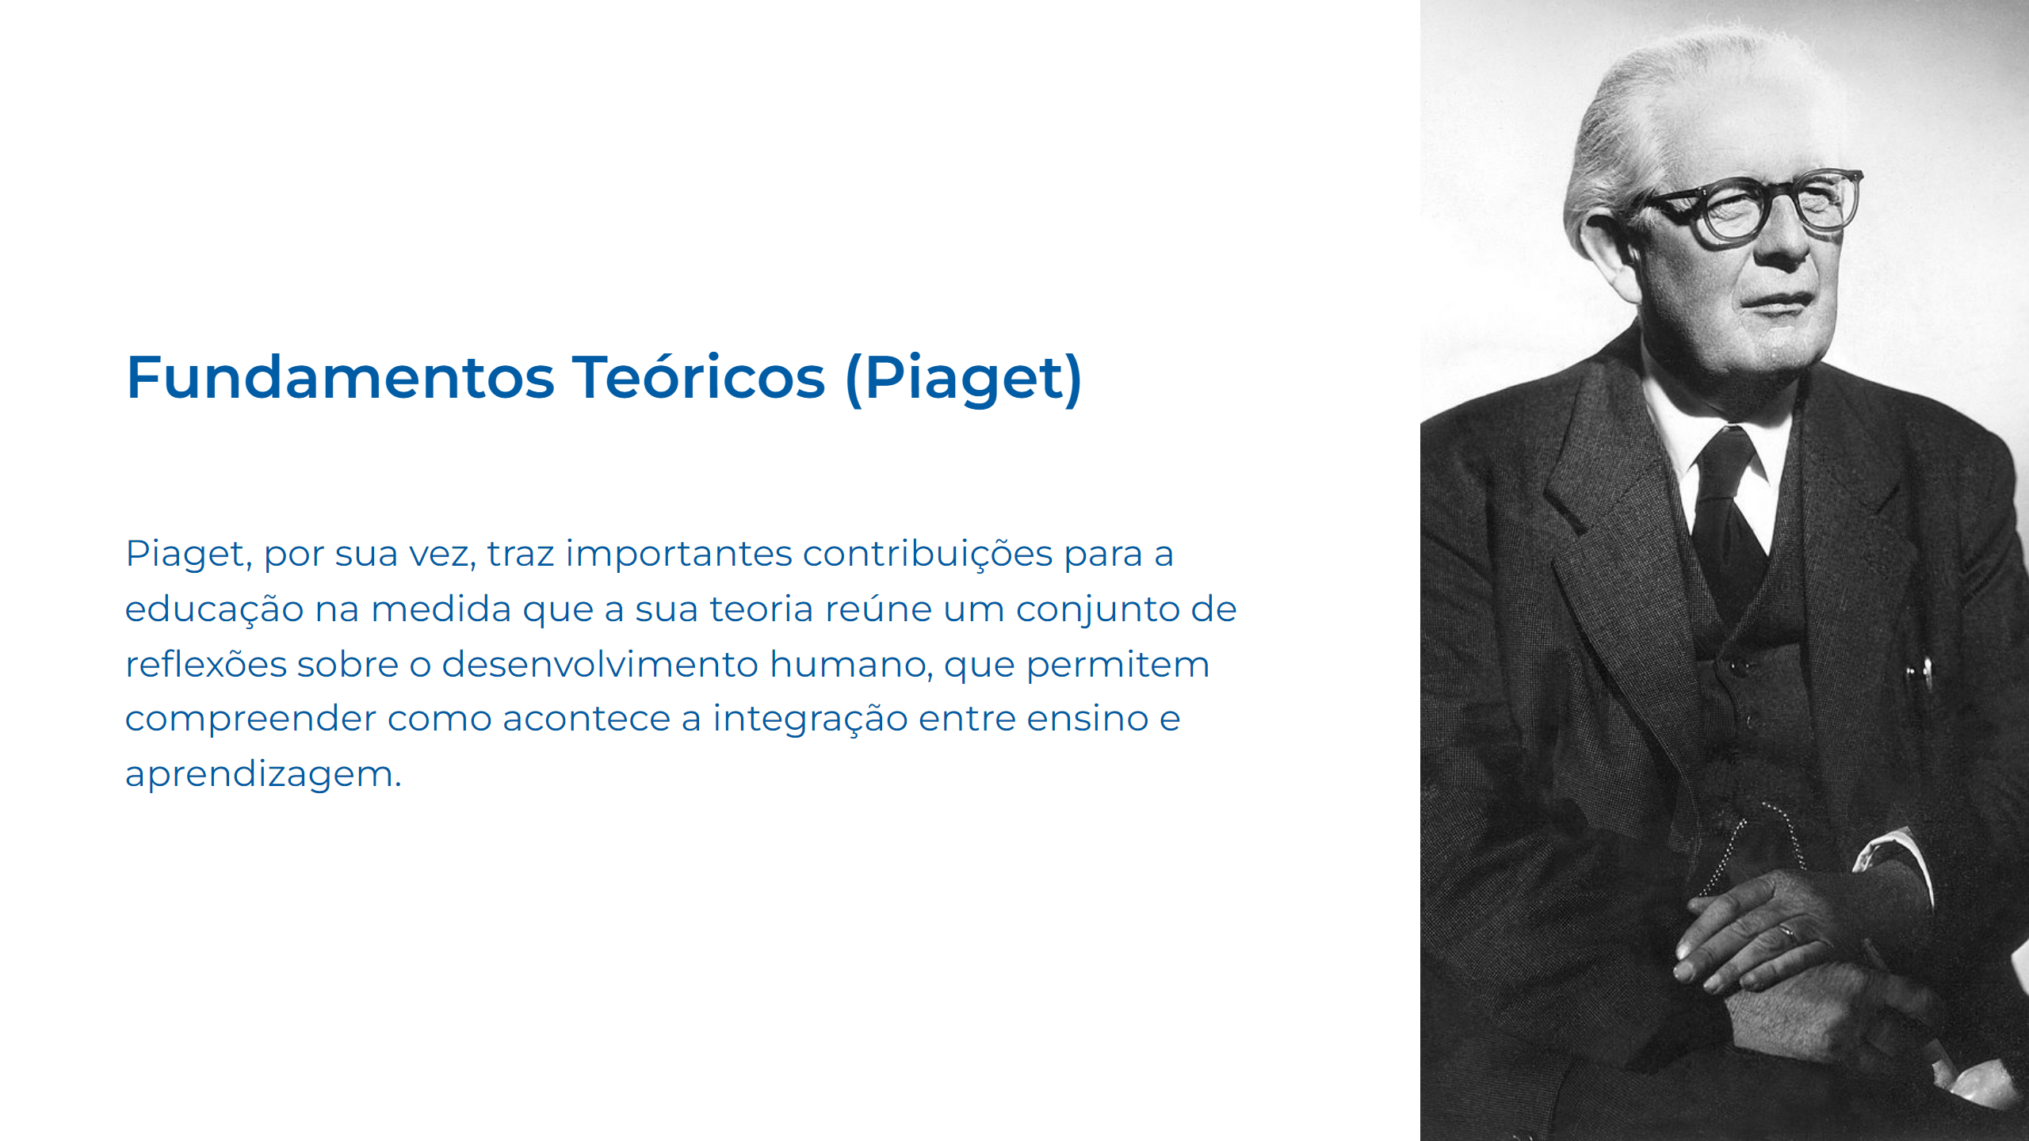
Notes:
Slide 10

Slide 11
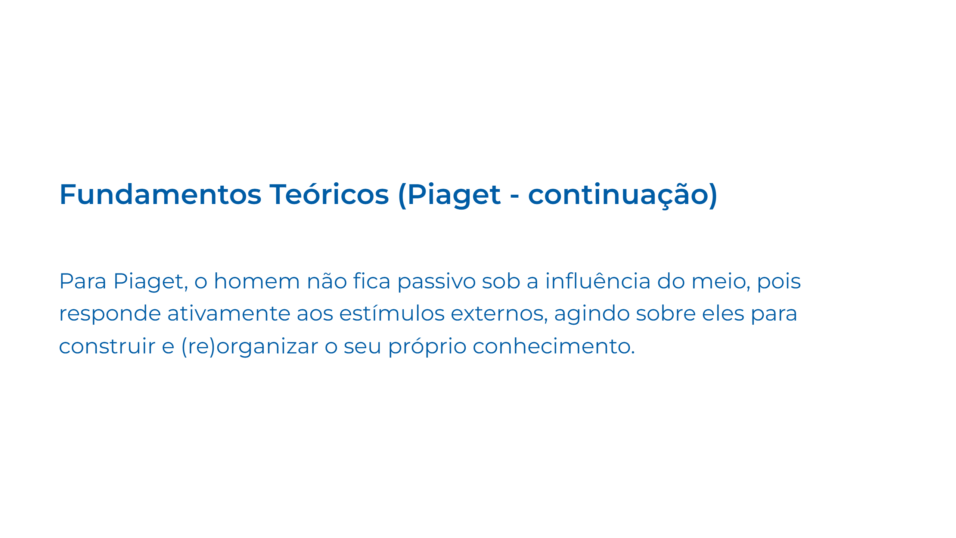
Notes:
Slide 11

Slide 12
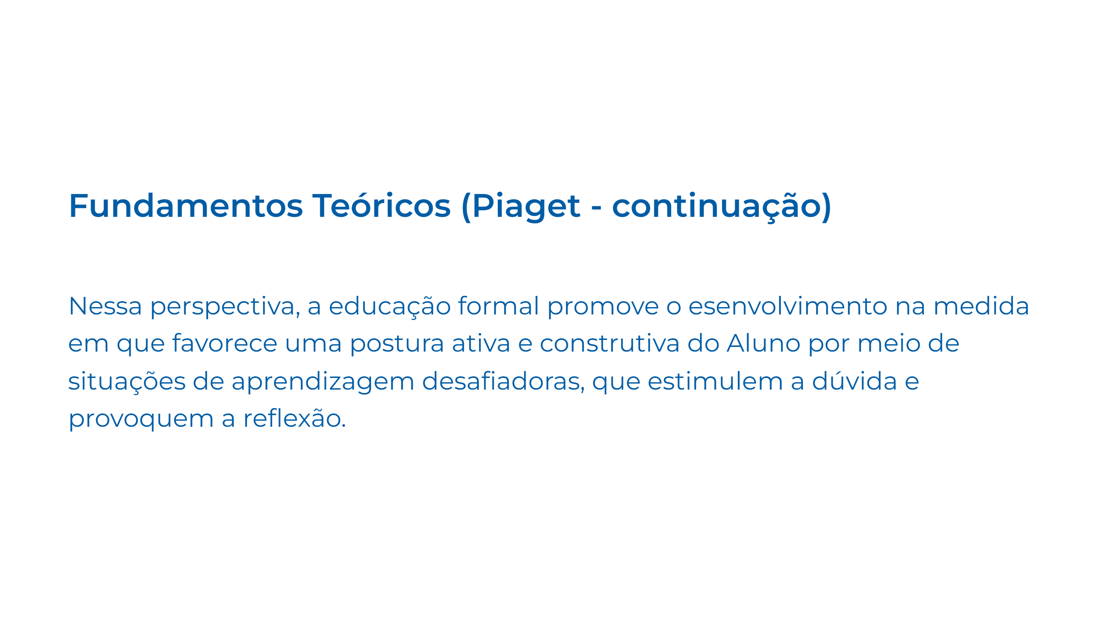
Notes:
Slide 12

Slide 13
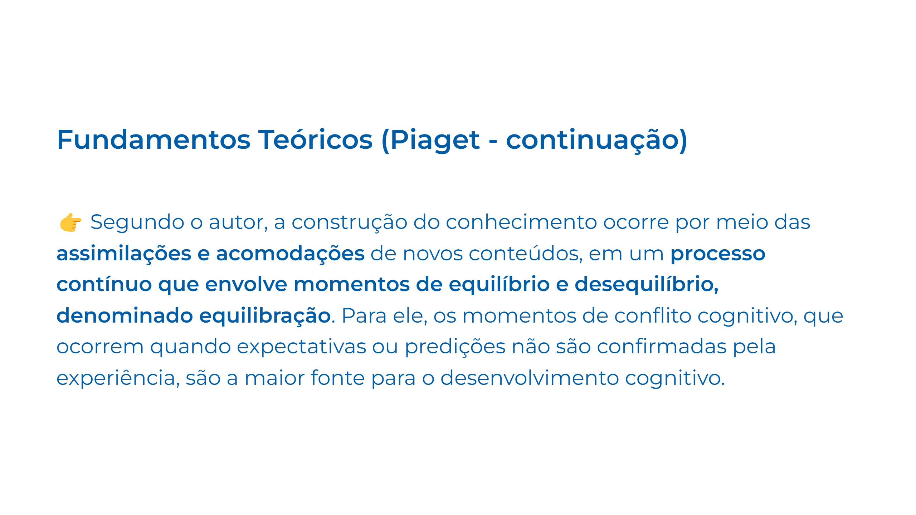
Notes:
Slide 13

Slide 14
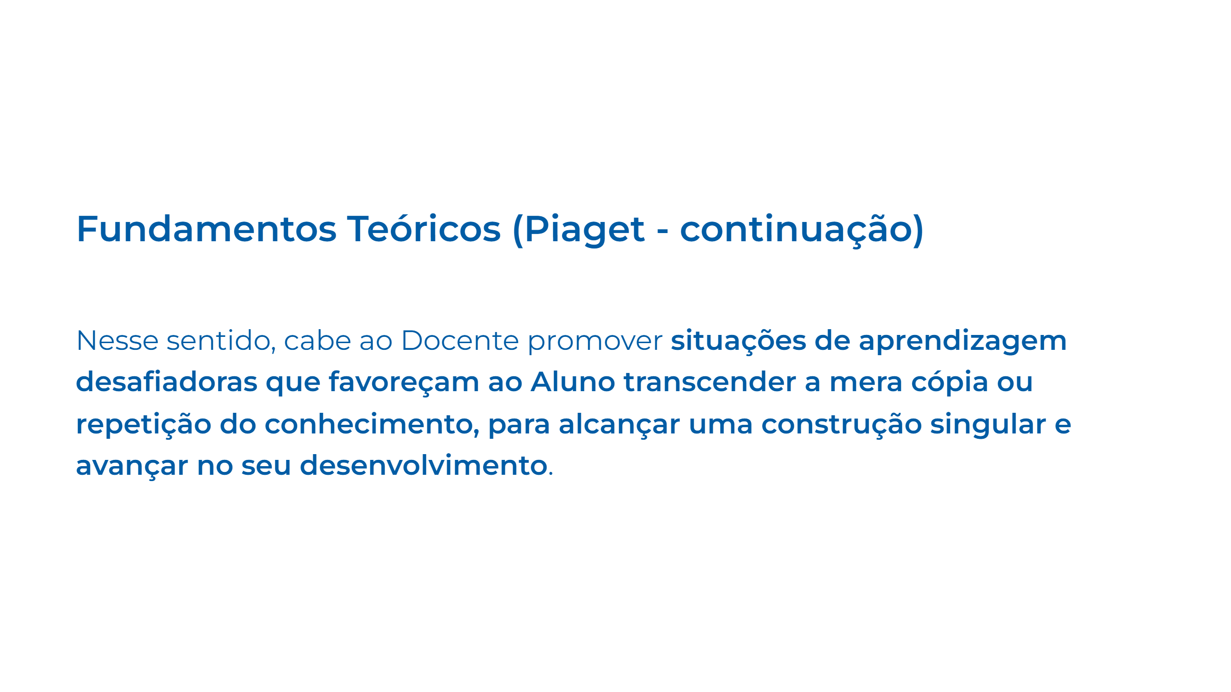
Notes:
Slide 14

Slide 15
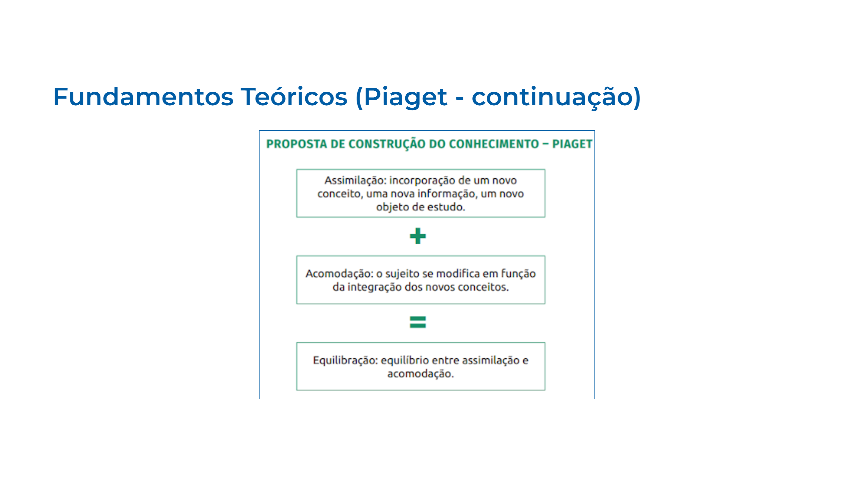
Notes:
Slide 15

Slide 16
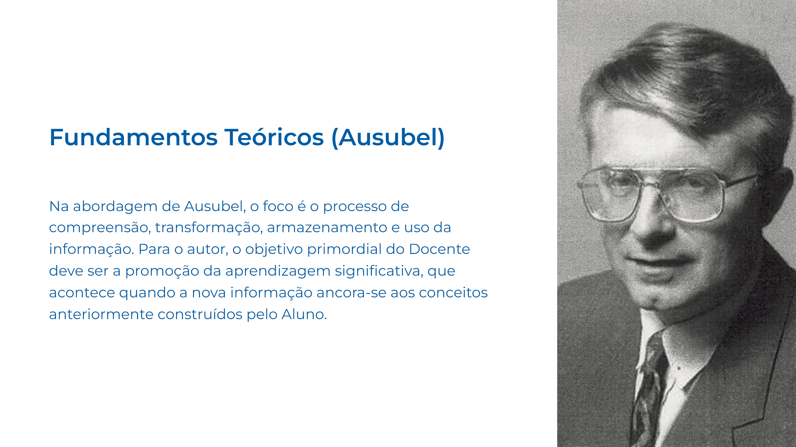
Notes:
Slide 16

Slide 17
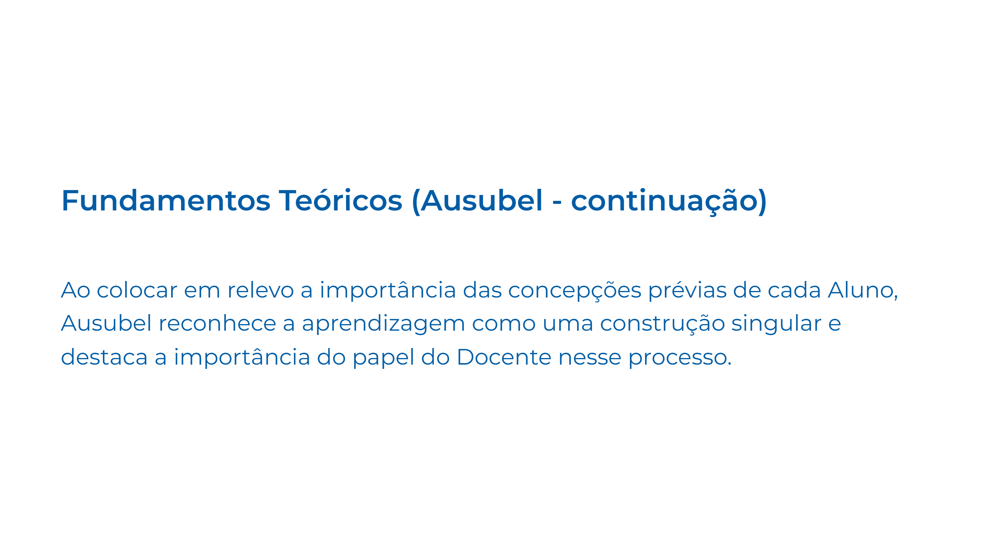
Notes:
Slide 17

Slide 18
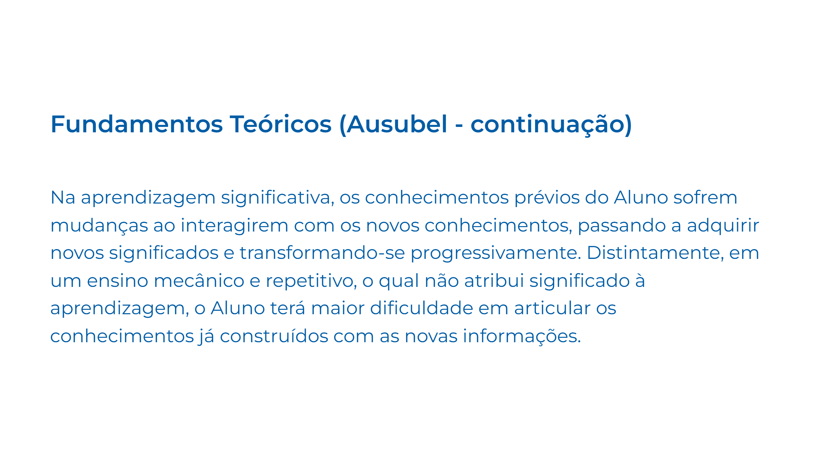
Notes:
Slide 18

Slide 19
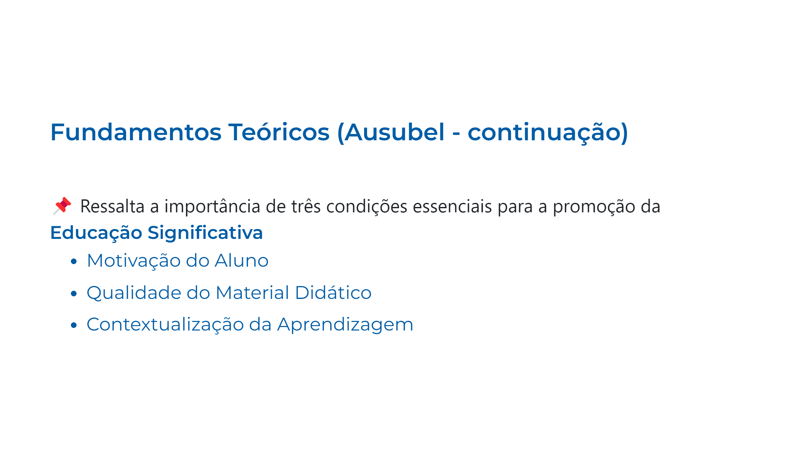
Notes:
Slide 19

Slide 20
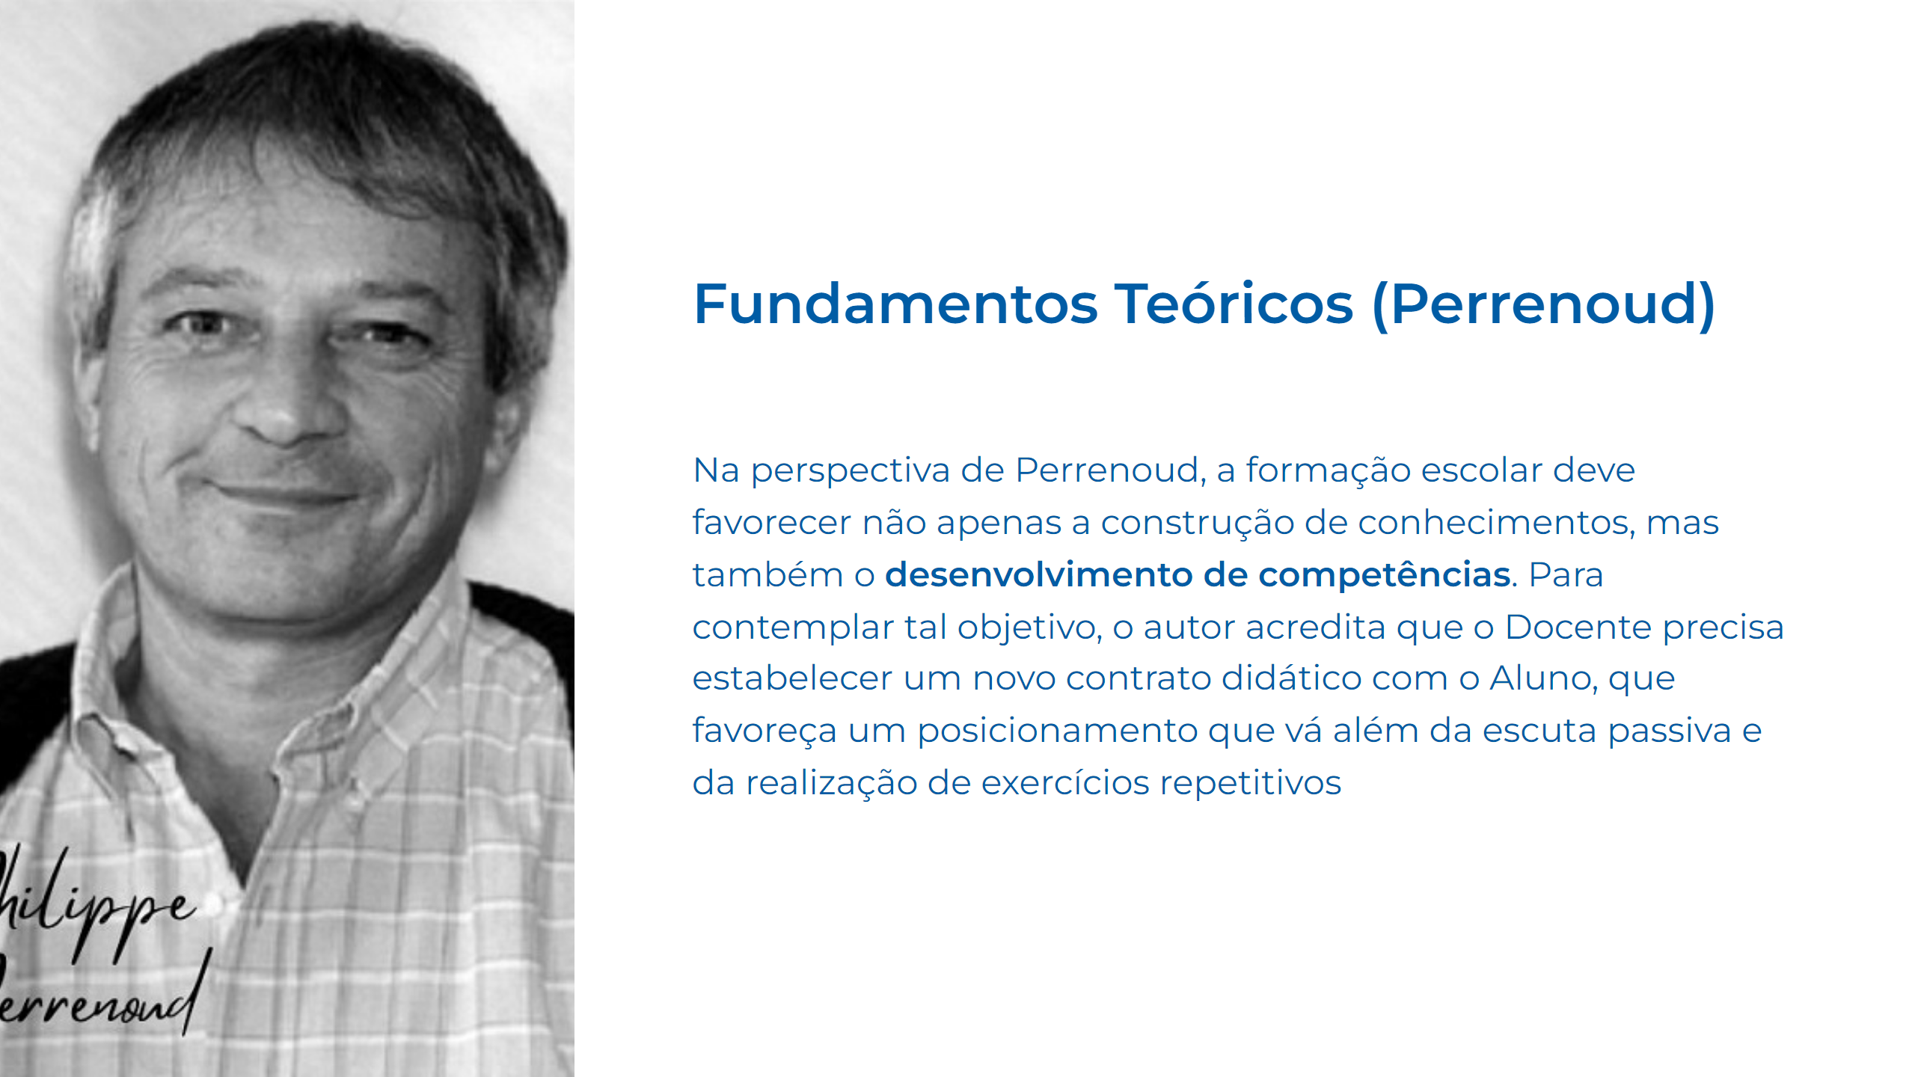
Notes:
Slide 20

Slide 21
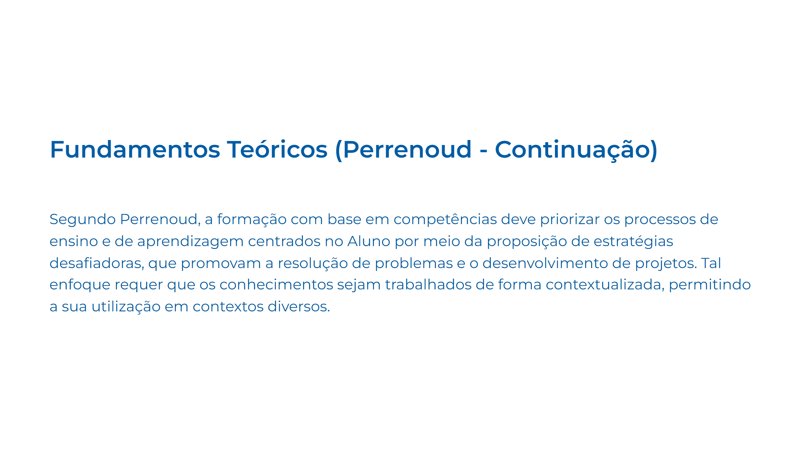
Notes:
Slide 21

Slide 22
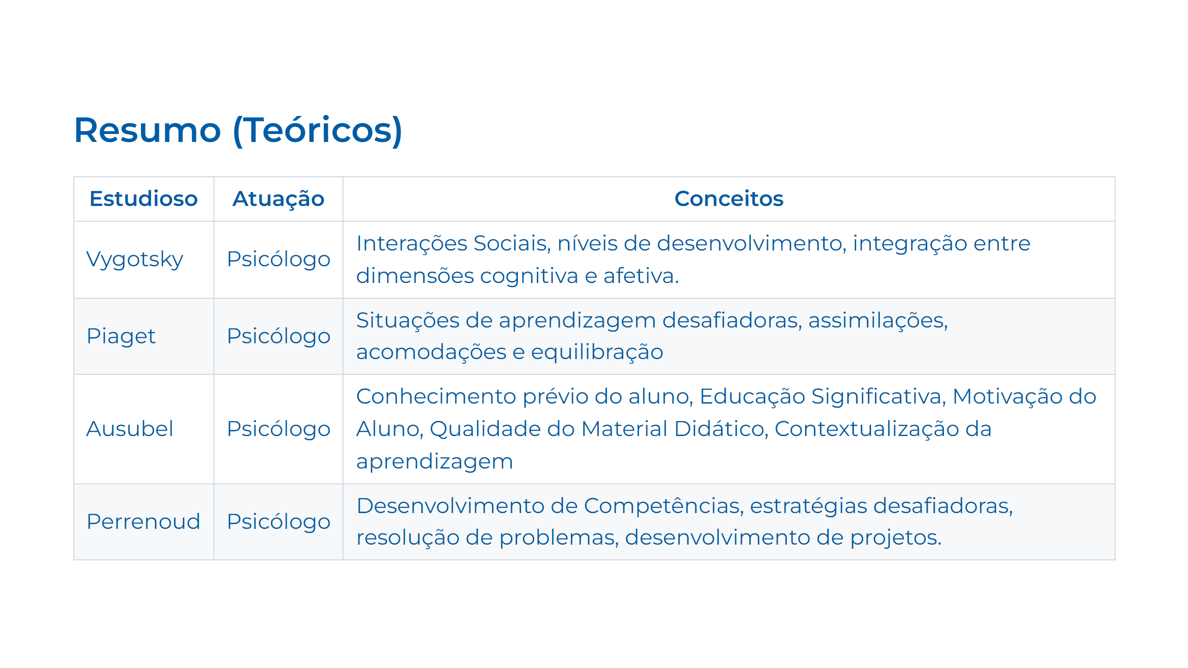
Notes:
Slide 22

Slide 23

Notes:
Slide 23

Slide 24
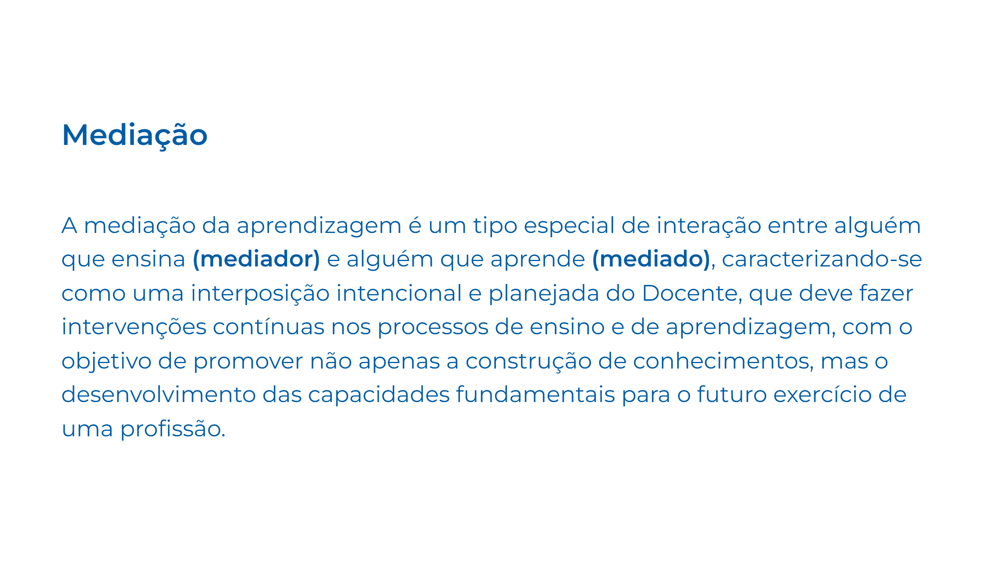
Notes:
Slide 24

Slide 25
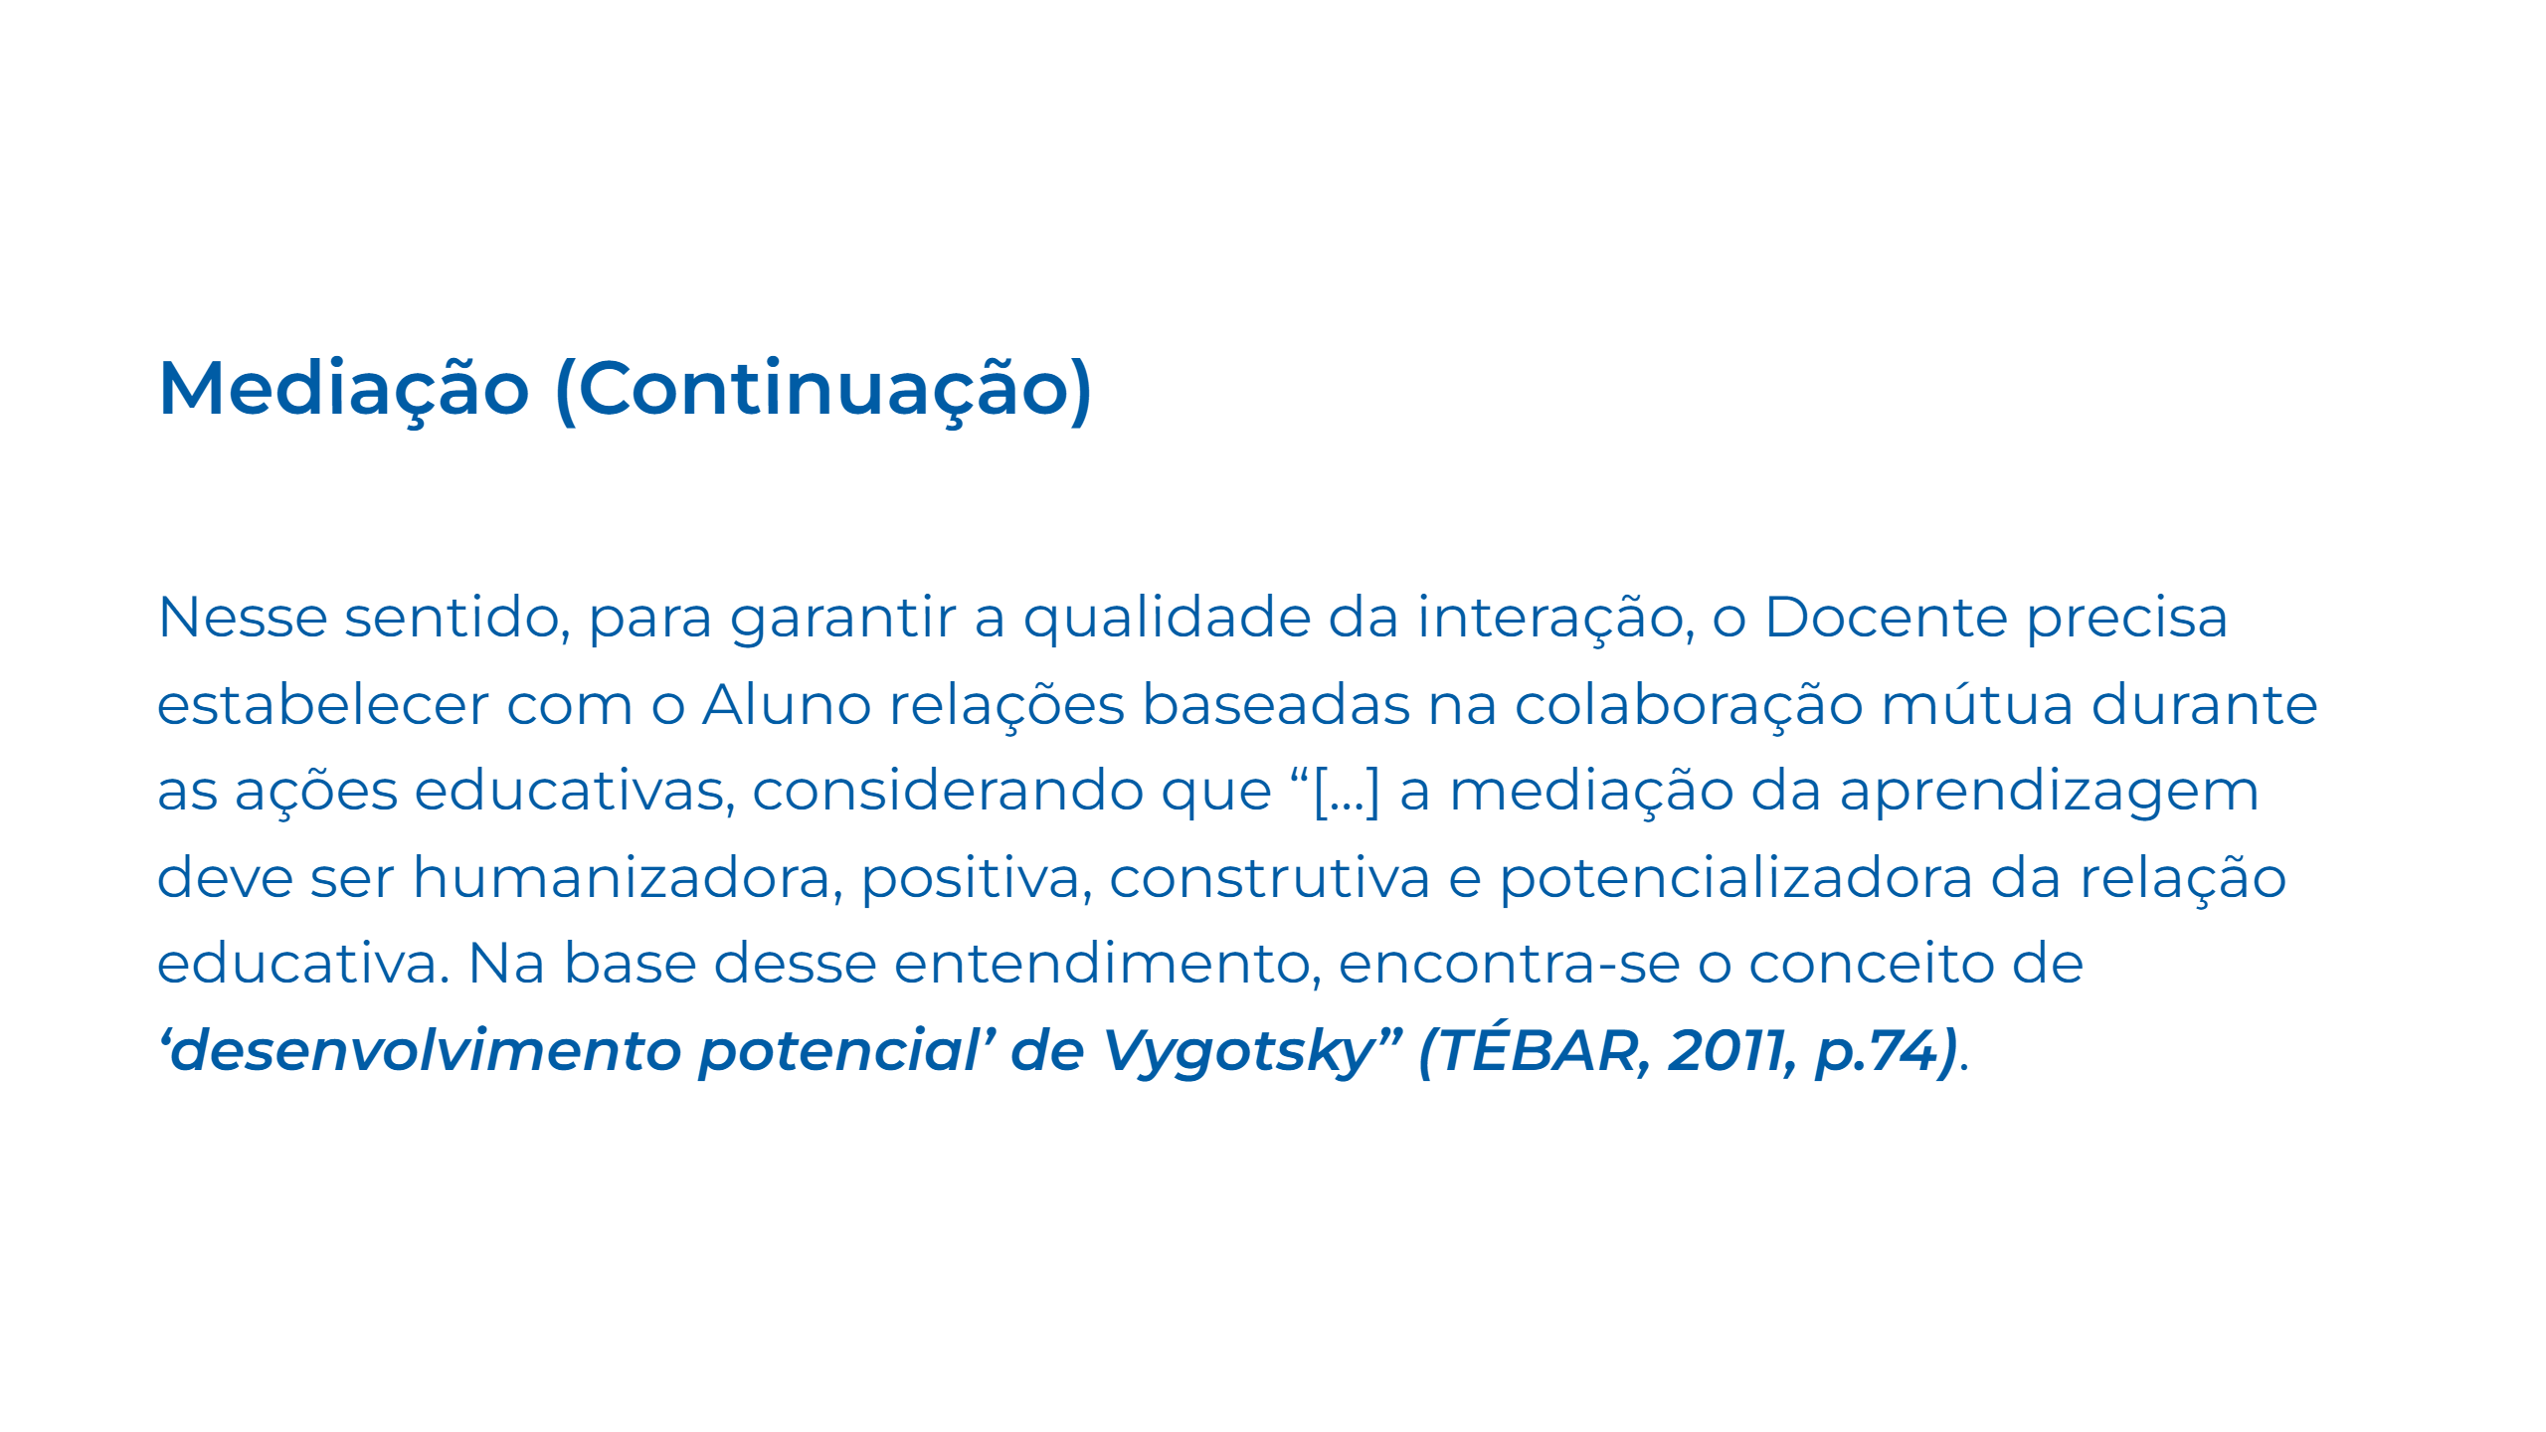
Notes:
Slide 25

Slide 26
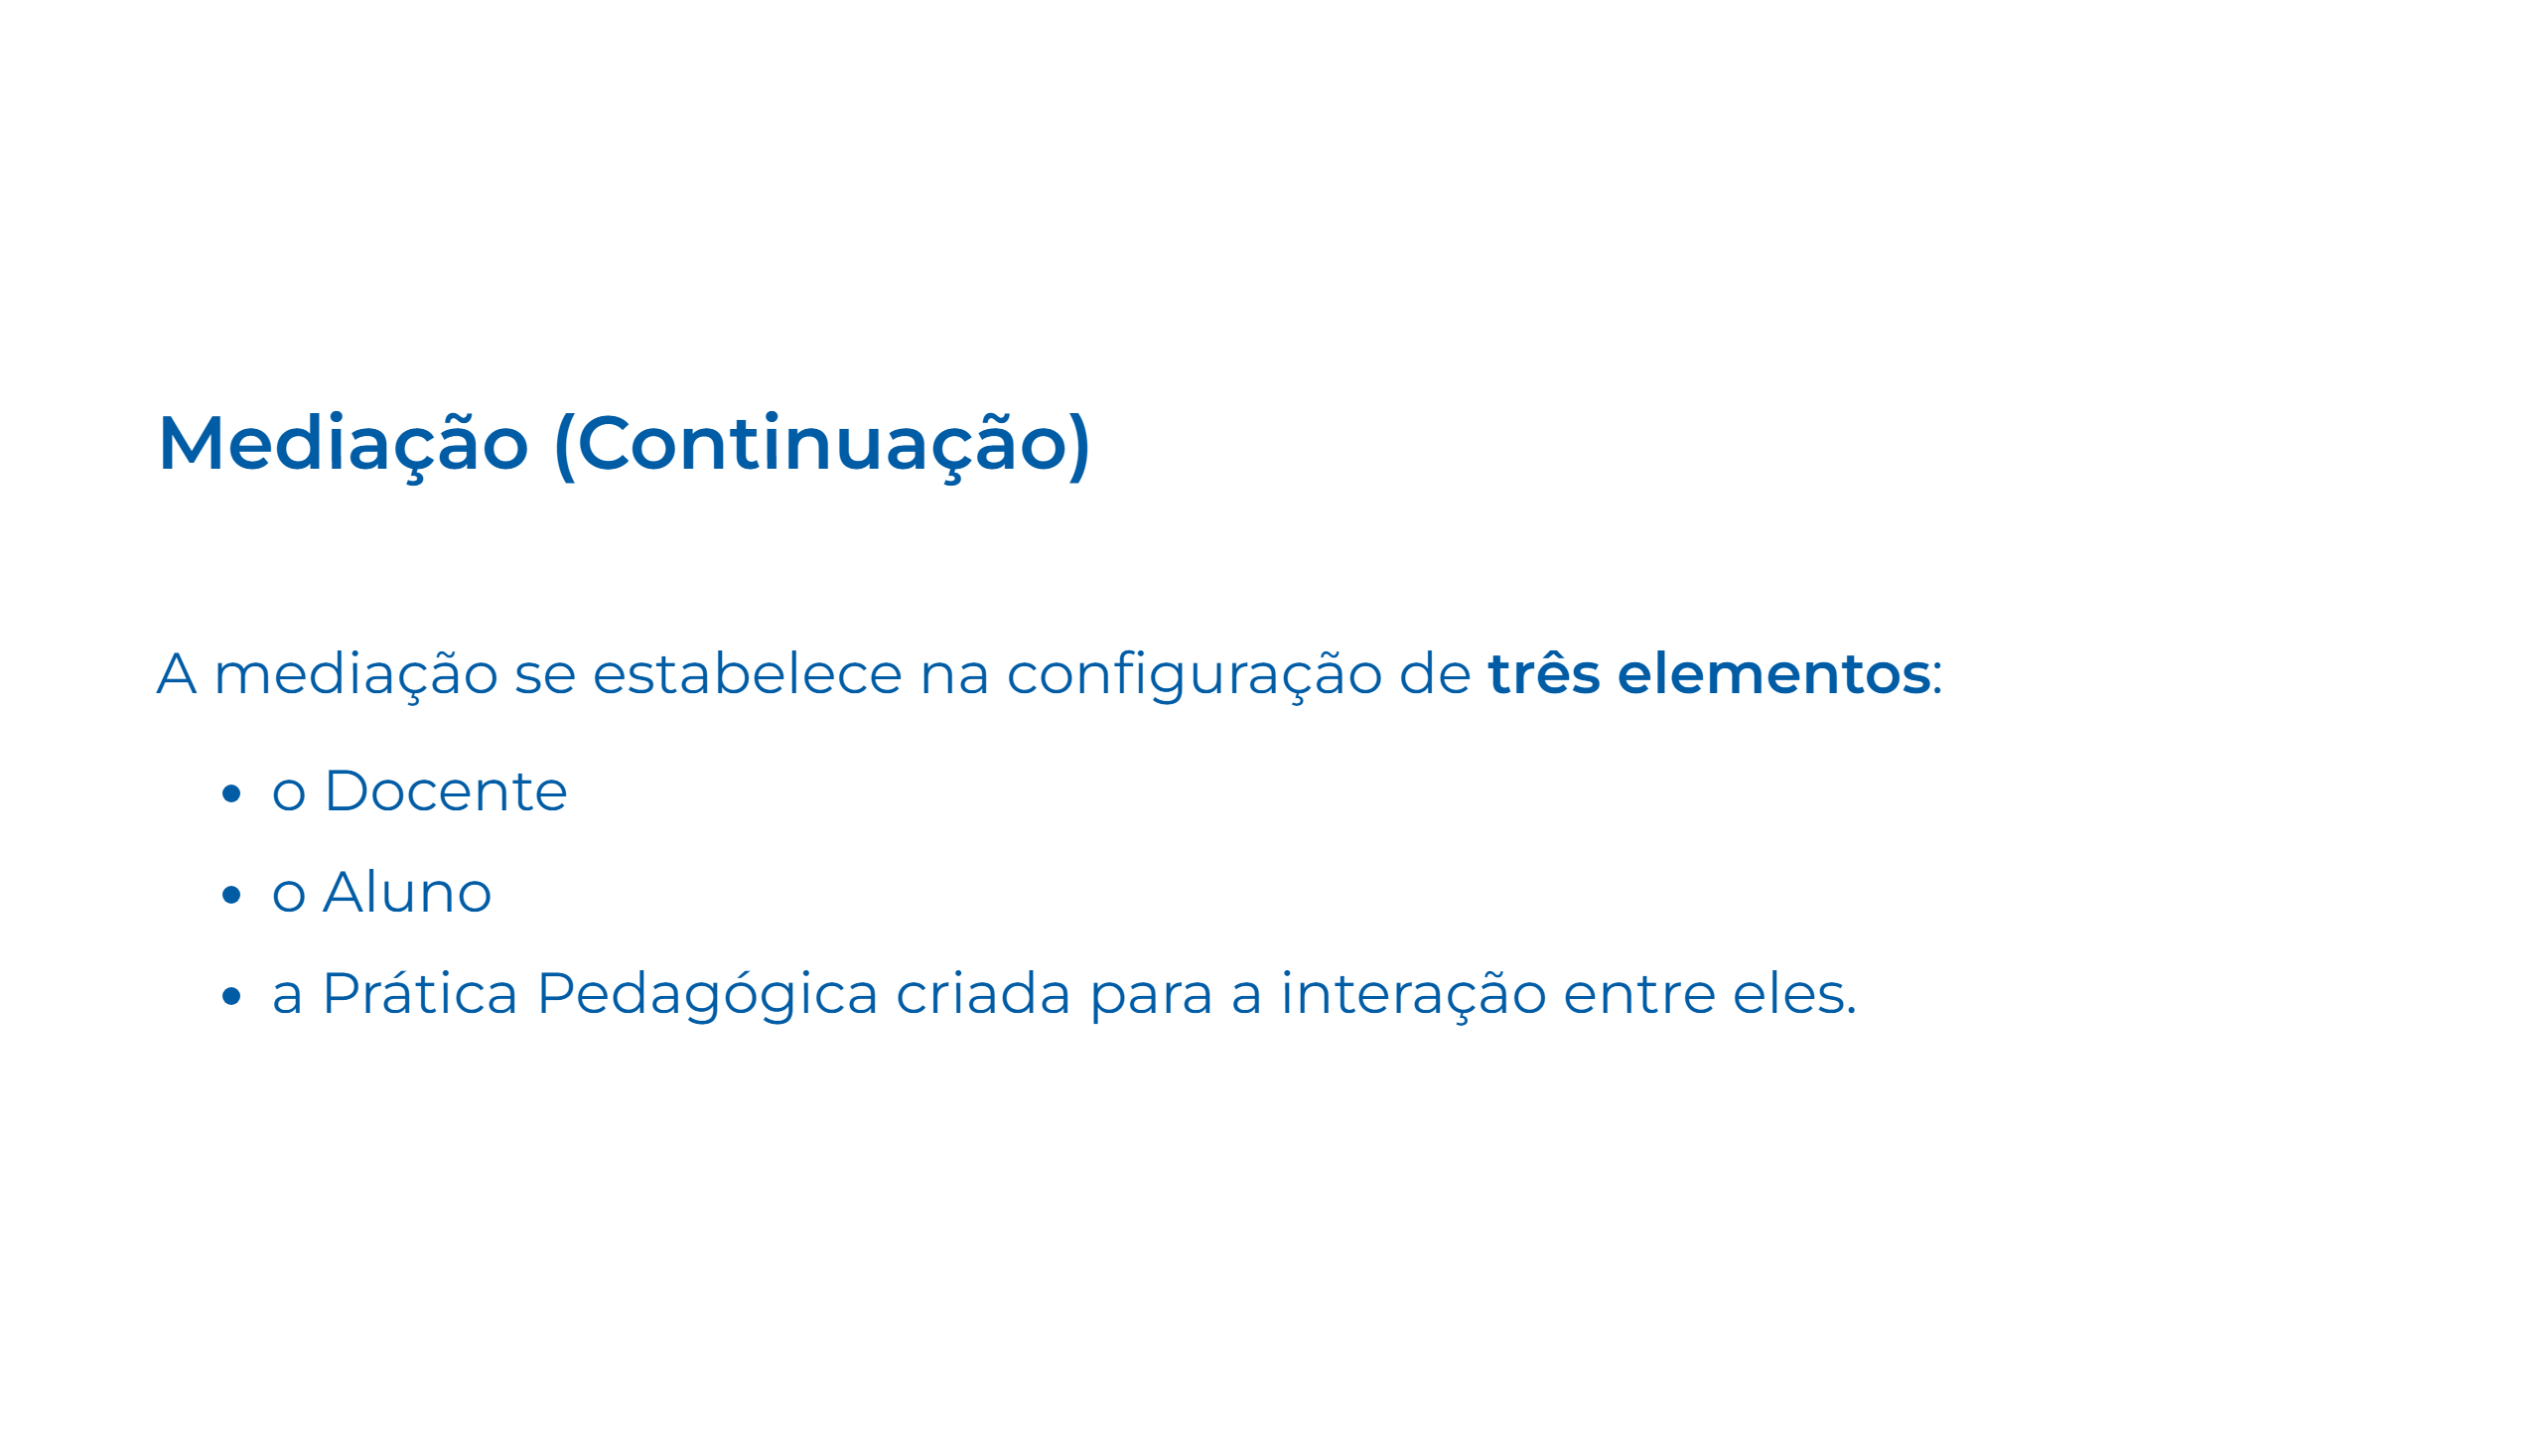
Notes:
Slide 26

Slide 27
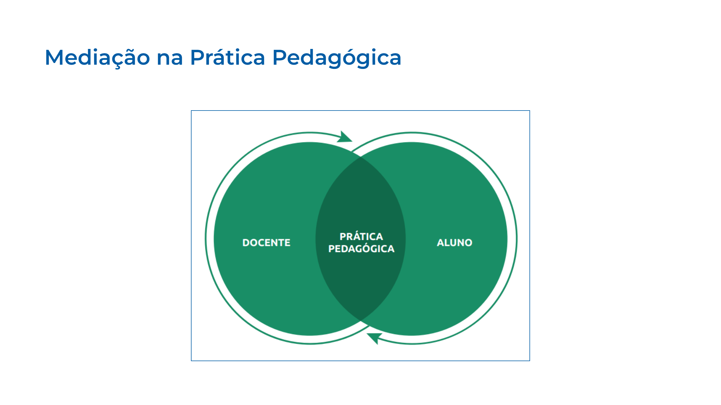
Notes:
Slide 27

Slide 28
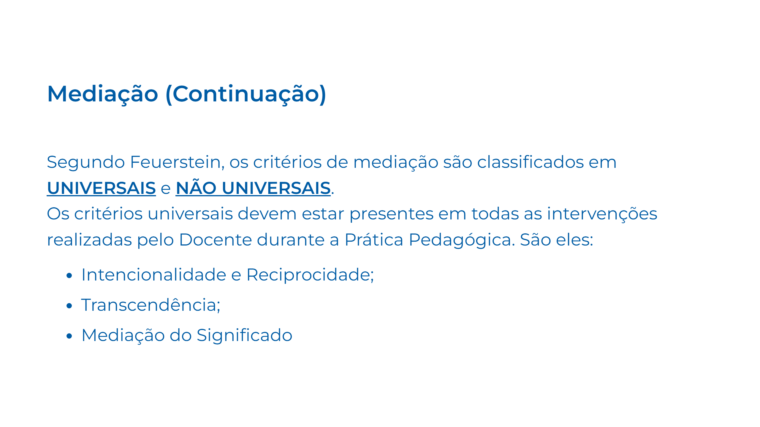
Notes:
Slide 28

Slide 29
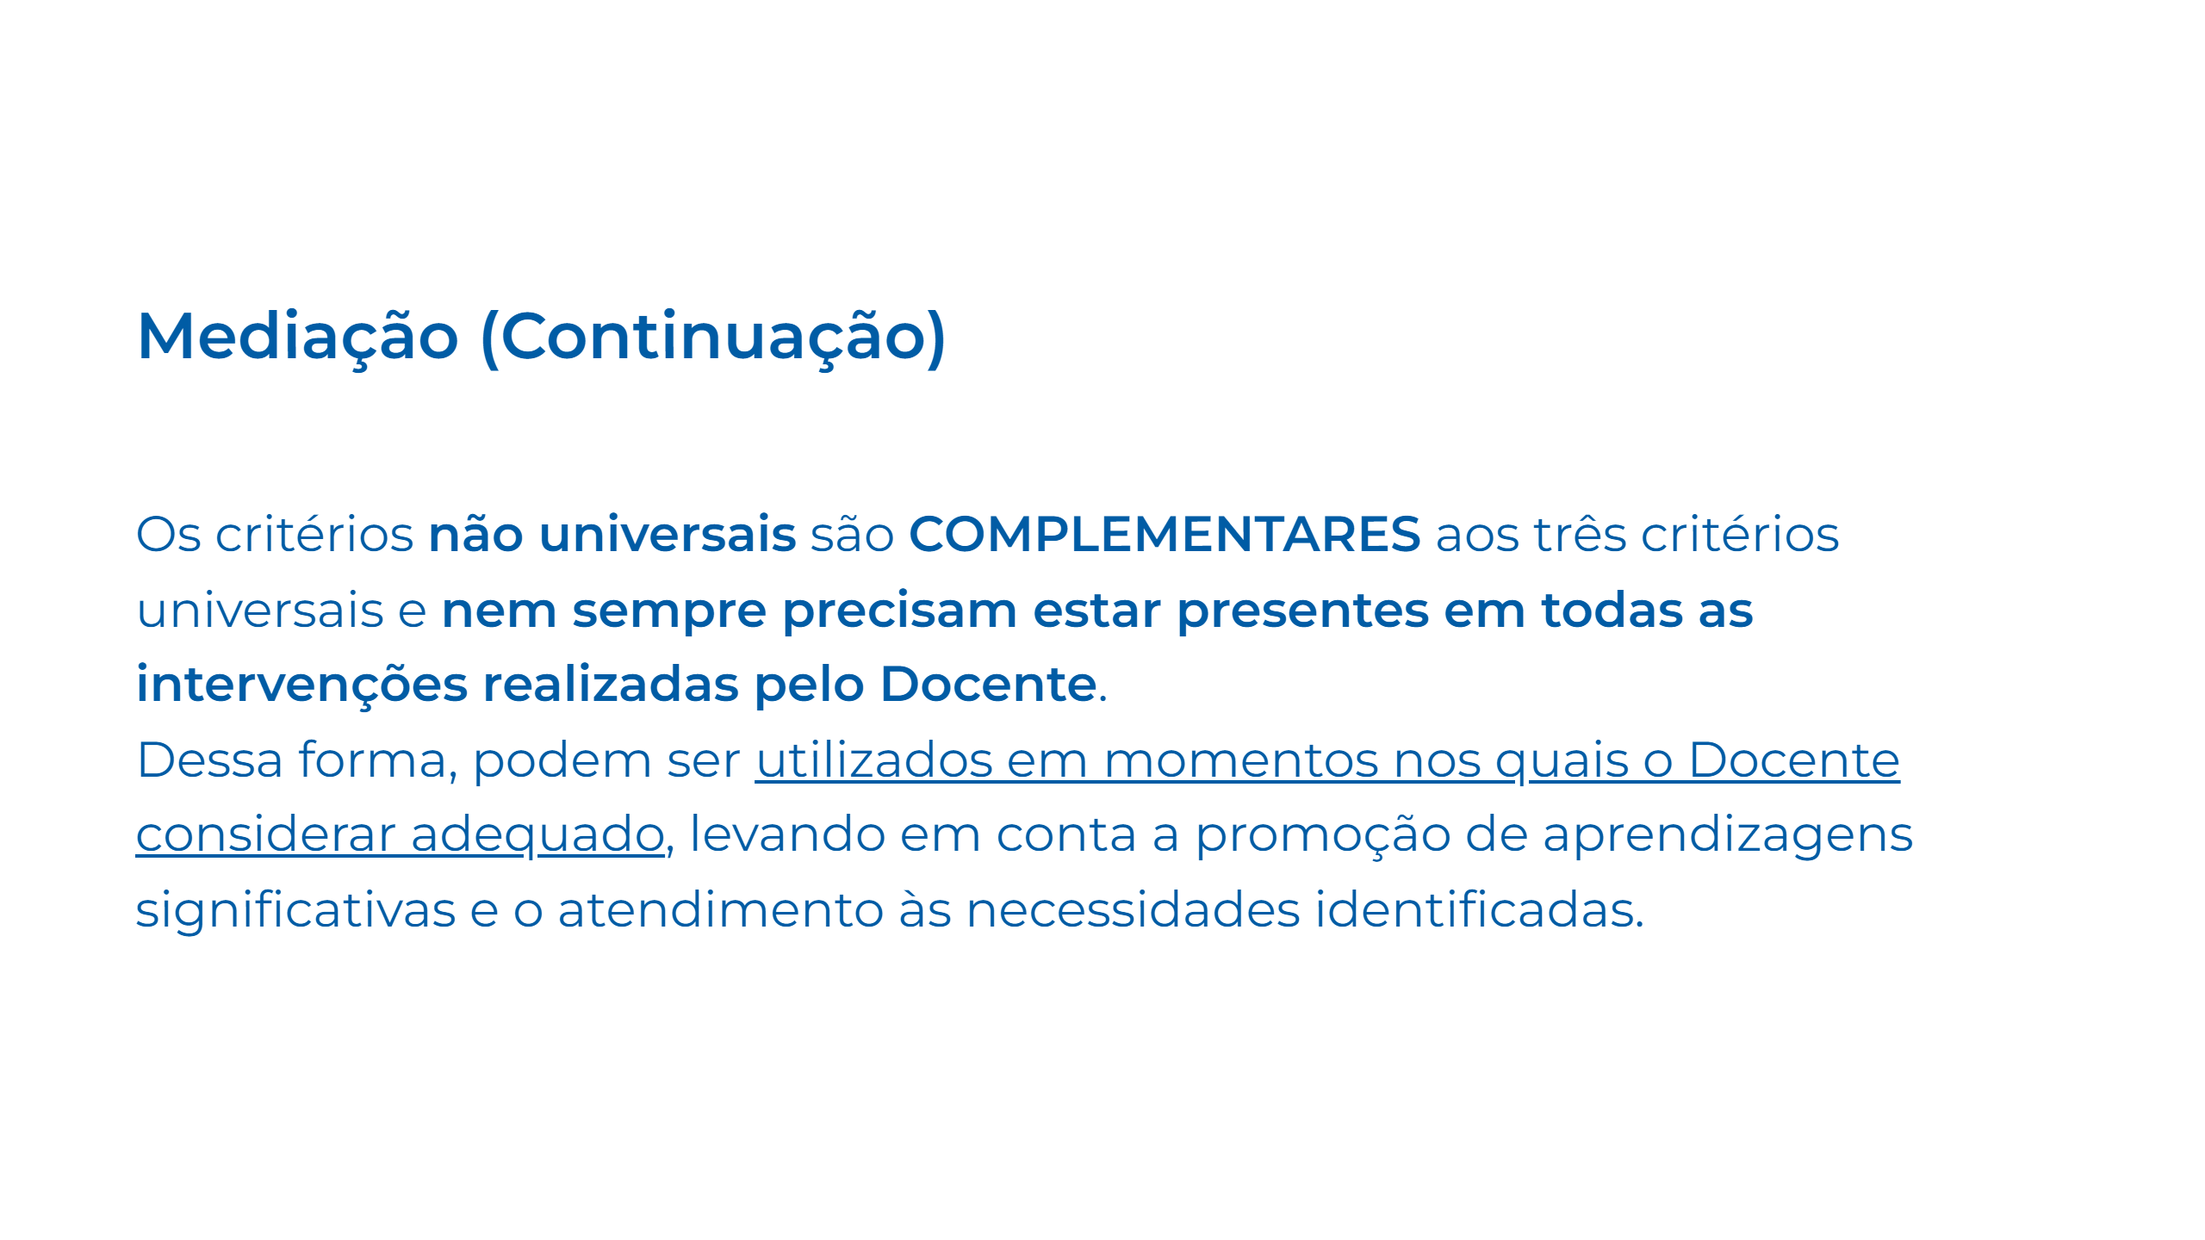
Notes:
Slide 29

Slide 30
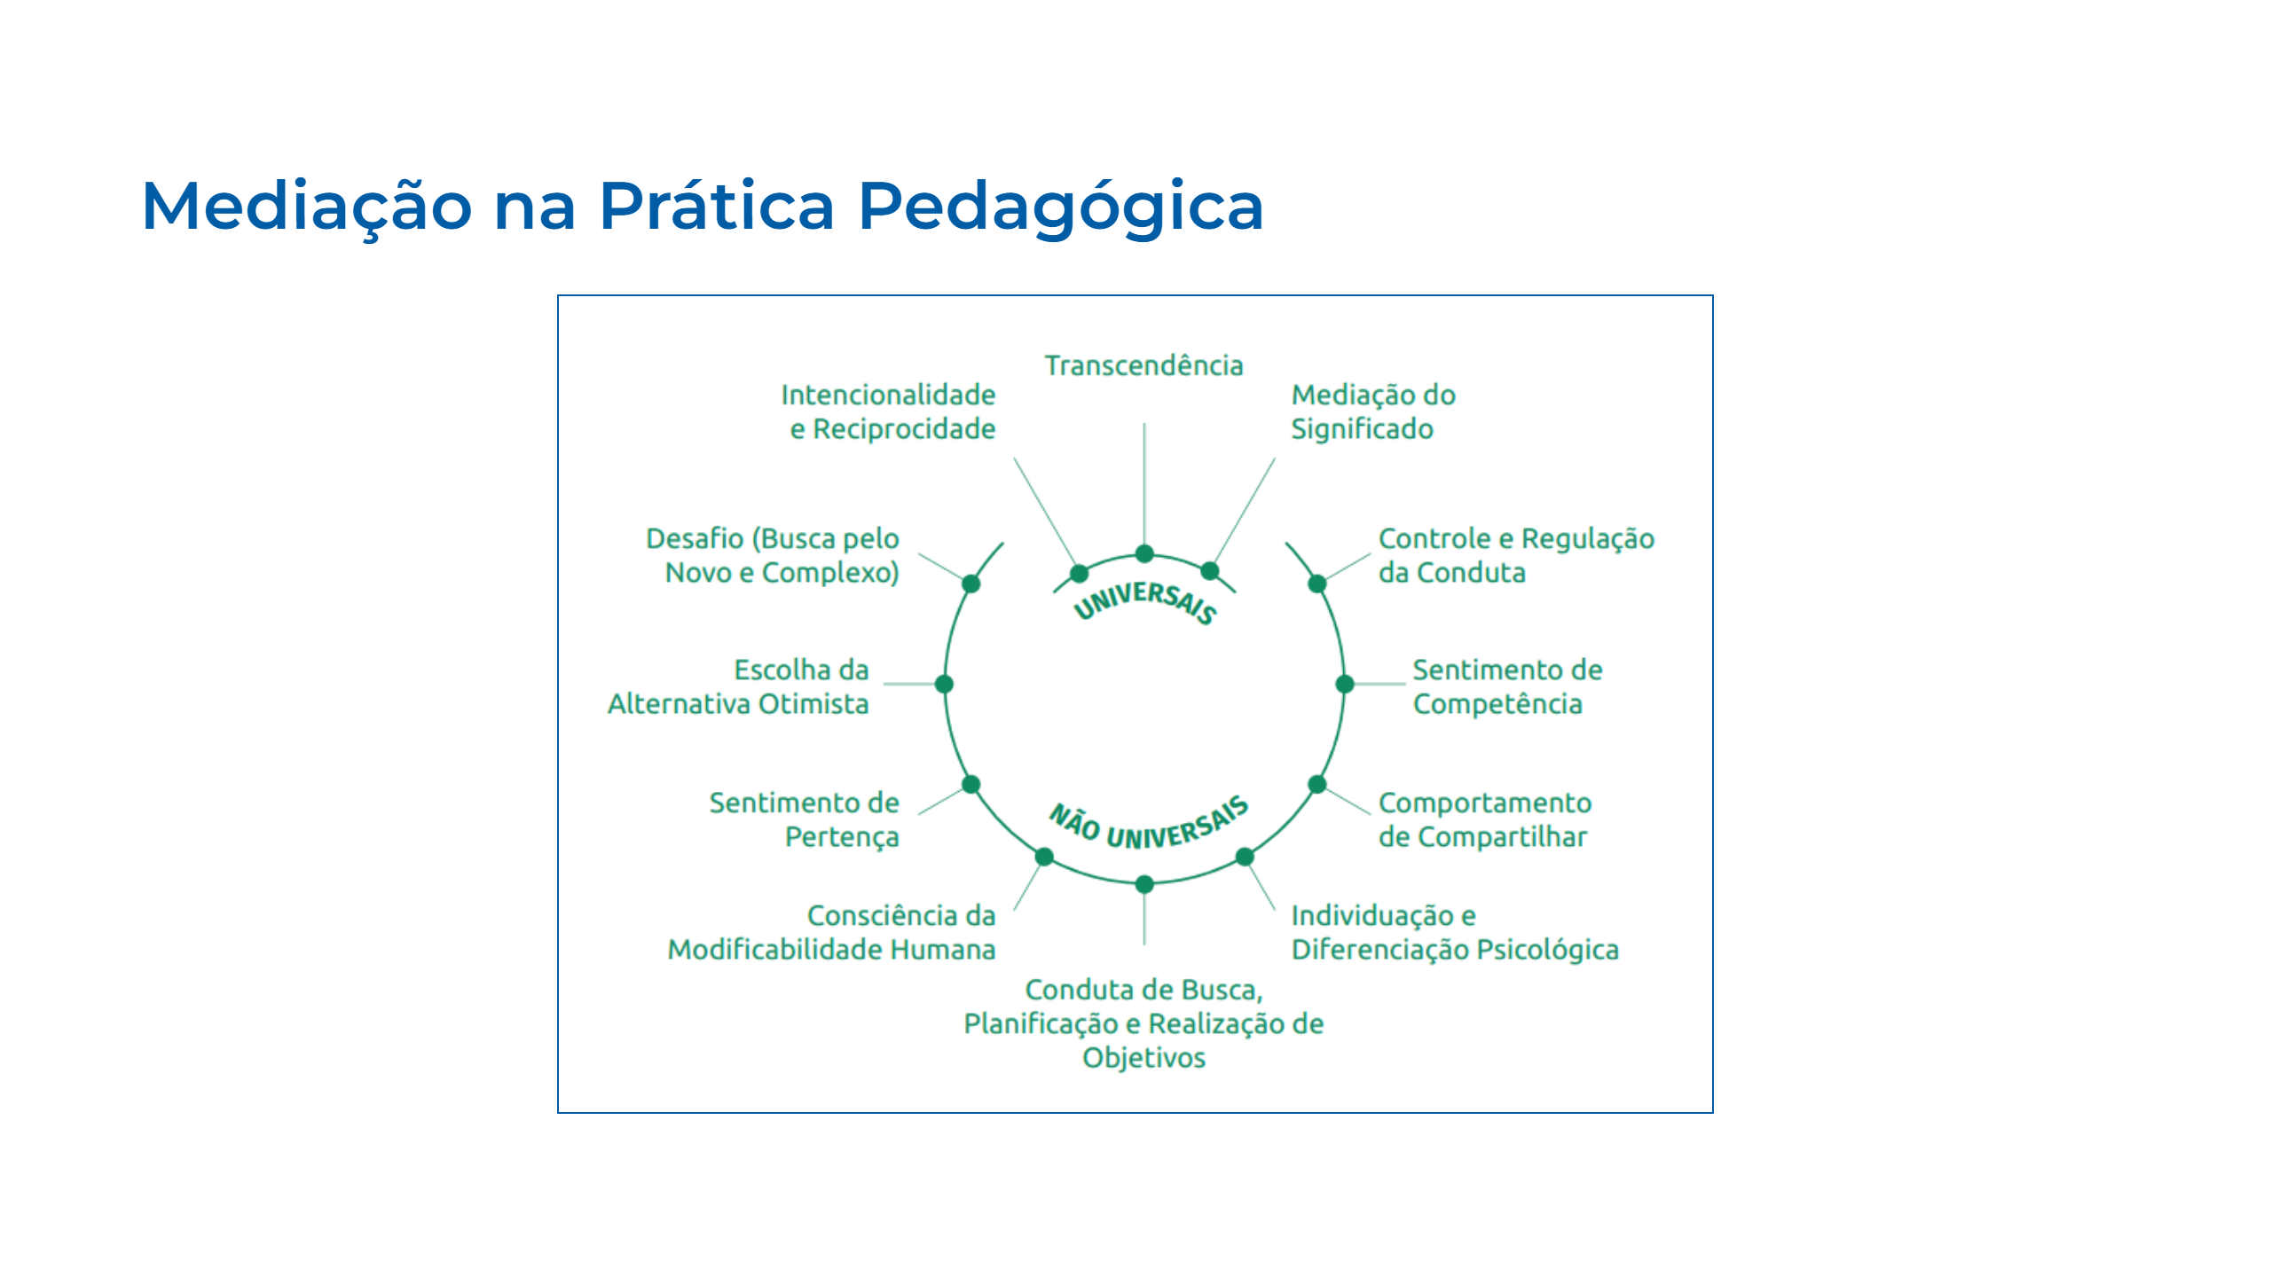
Notes:
Slide 30

Slide 31
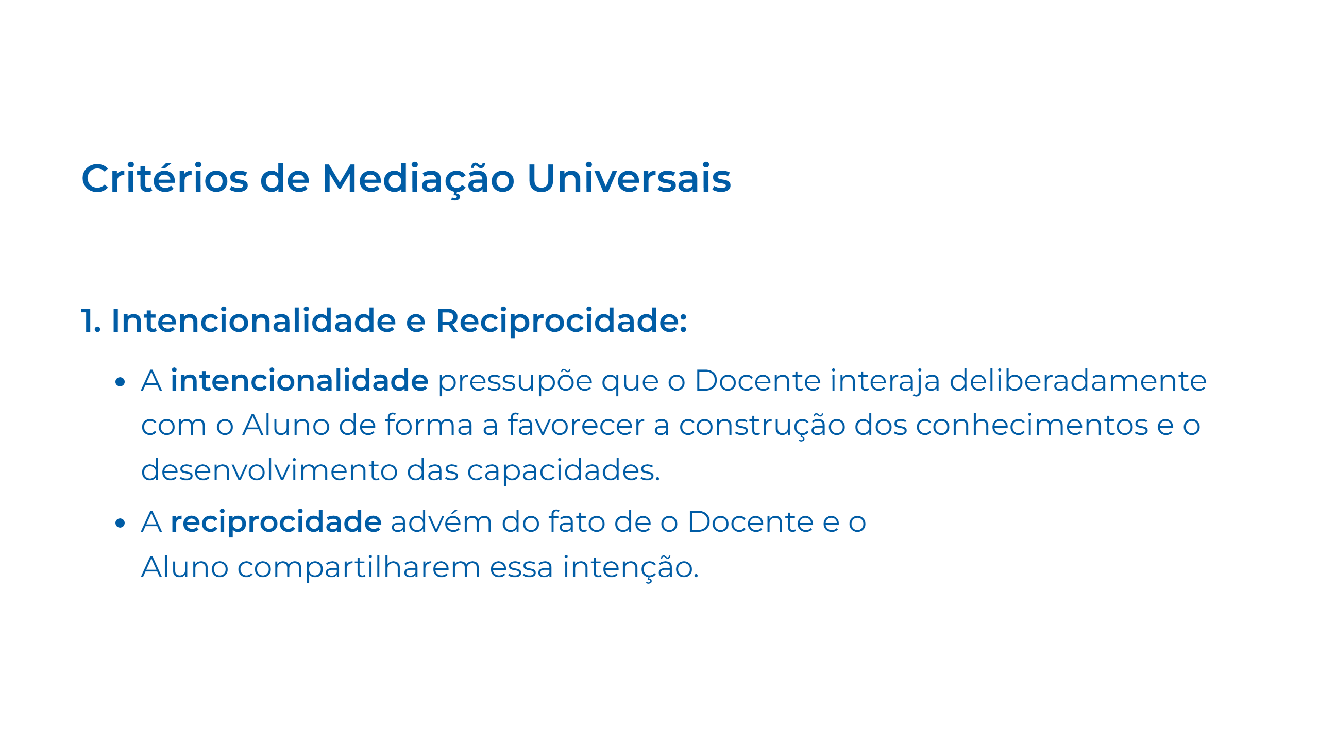
Notes:
Slide 31

Slide 32
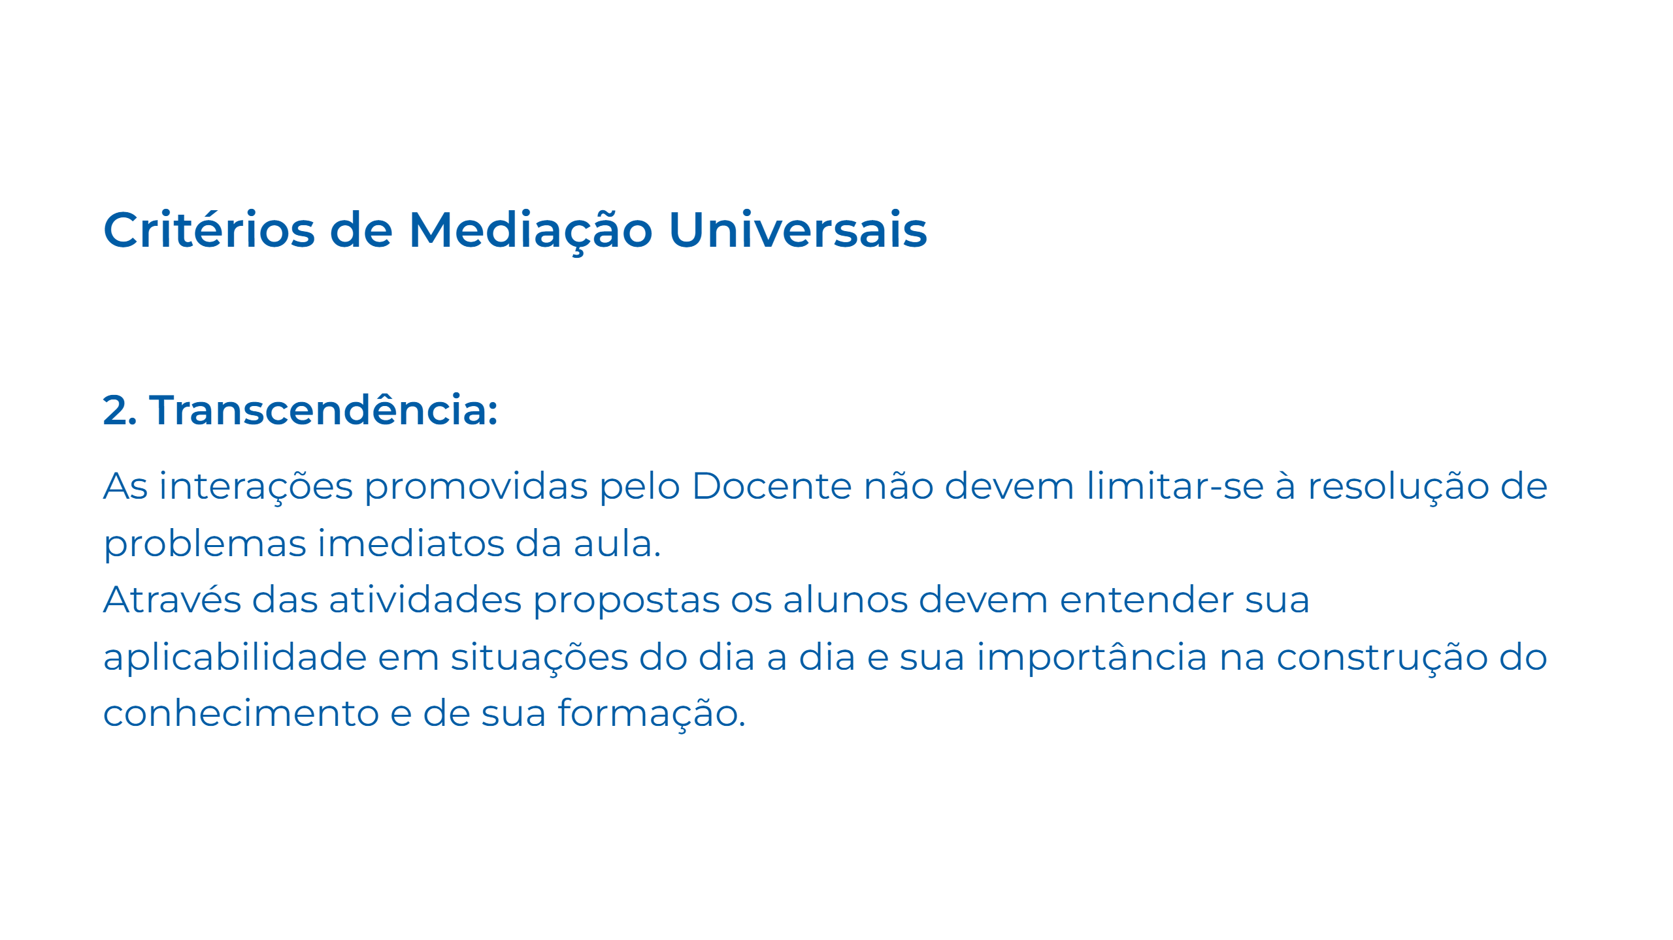
Notes:
Slide 32

Slide 33
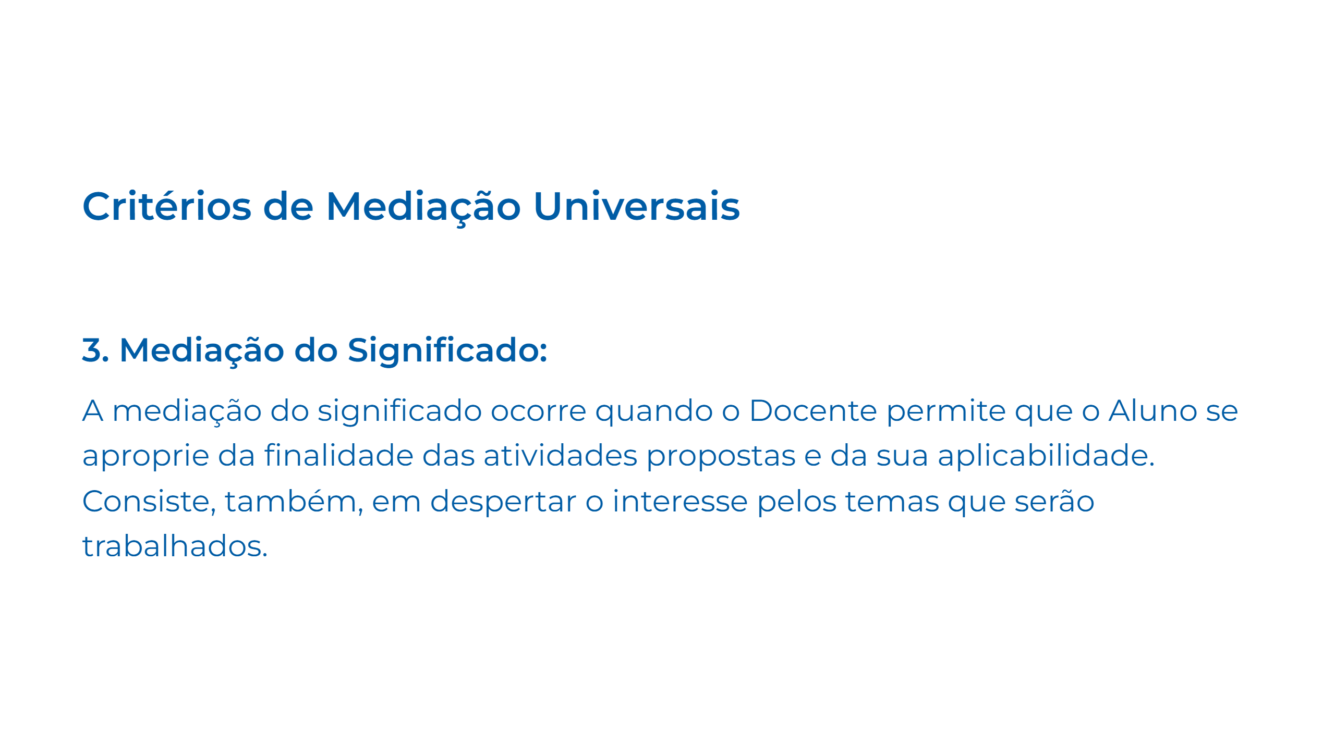
Notes:
Slide 33

Slide 34
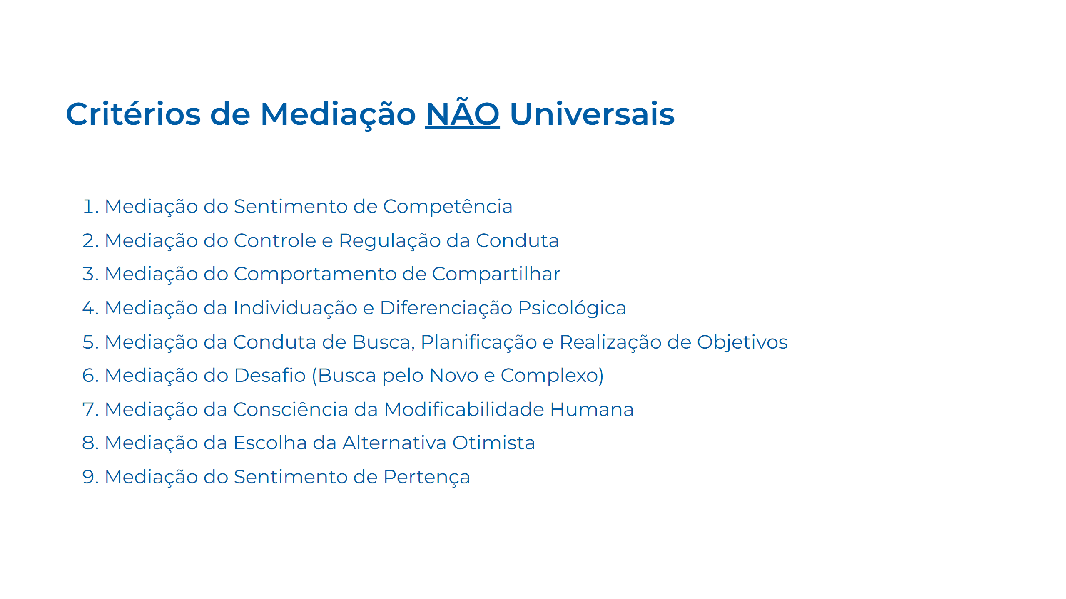
Notes:
Slide 34

Slide 35
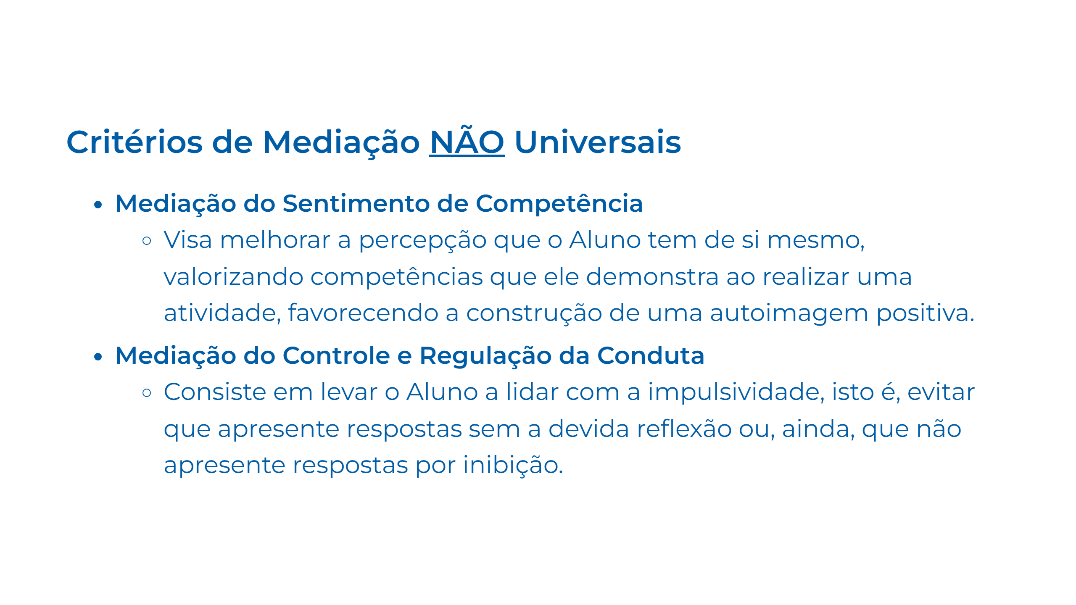
Notes:
Slide 34

Slide 36
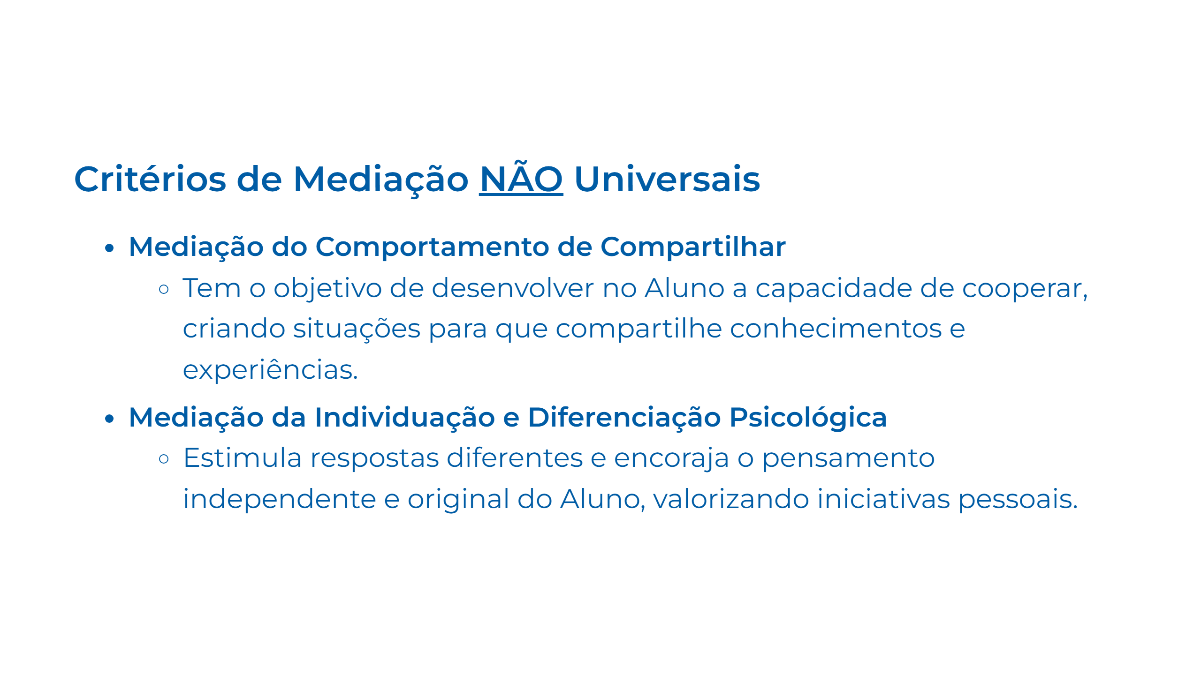
Notes:
Slide 35

Slide 37

Notes:
Slide 36

Slide 38

Notes:
Slide 37

Slide 39

Notes:
Slide 38

Slide 40

Notes:
Slide 39

Slide 41

Notes:
Slide 40

Slide 42
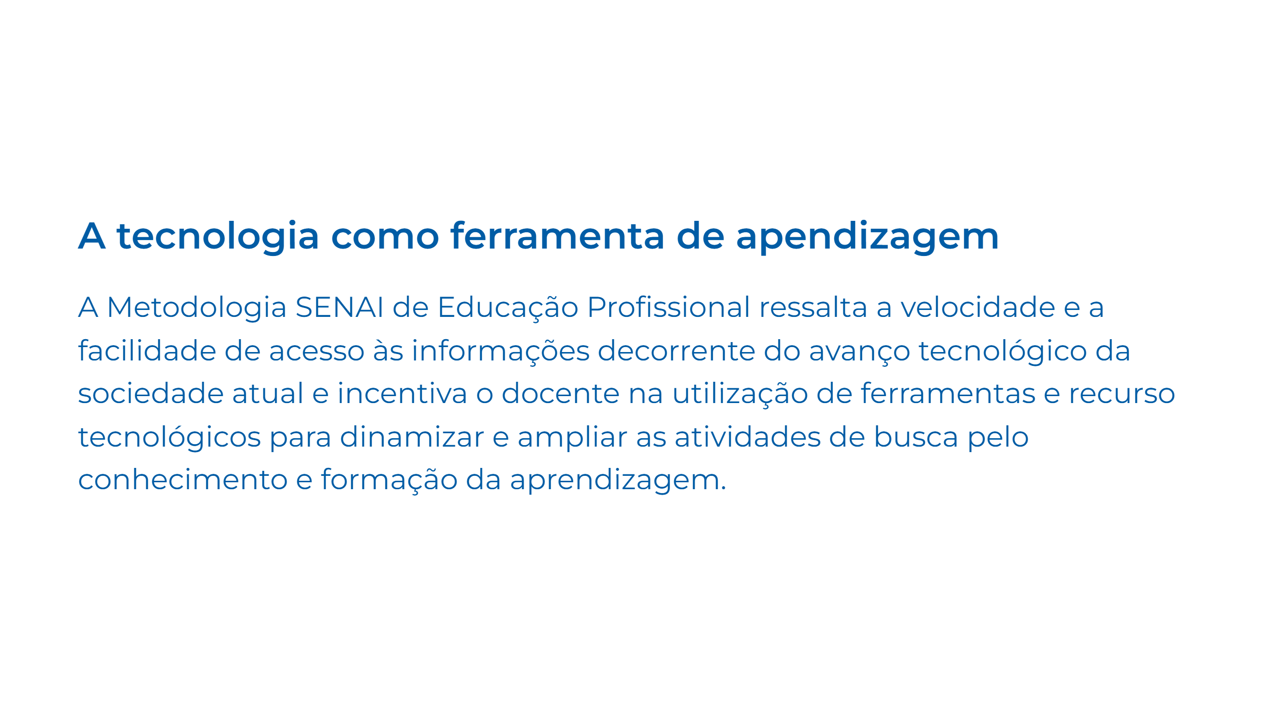
Notes:
Slide 40

Slide 43

Notes:
Slide 42 exportar md -> pdf ctrl + shift + p: Markdown PDF export PDF exportar md -> html ctrl + shift + p: Markdown PDF export html visualizar (preview) ctrl + shift + p: Open Preview Material de consulta sobre MARP https://chris-ayers.com/2023/03/31/customizing-marp https://github.com/marp-team/marp-cli/blob/main/docs/bespoke-transitions/README.md#built-in-transitions https://dev.to/andyhaskell/write-your-tech-talk-slides-rapidly-with-marp-2c7g https://github.com/marp-team/awesome-marp?tab=readme-ov-file https://marp.app/blog/202205-ecosystem-update https://ecovida.org.br/docs/manual_site/markdown/list/ referências Imagem: Capa: https://cdn.midjourney.com/64f05014-06df-471b-bd74-df45c33fac62/0_2.png Vygotsky: https://thumbor.novaescola.org.br/dKDsoUlC96gaKVTbZACnIxTnRPo=/nova-escola-producao.s3.amazonaws.com/bEfDZ4fKF4EzWjTxYmCfnAQj65PpJ7hSXxgTaVrJRyGwg4tK6W2ScKdxX2yM/lev-vygotsky.jpg Piaget: https://nova-escola-producao.s3.amazonaws.com/8AHENheKXfqmTKHB9tY6vPztT2wxyxE3MjErgTdae43g6guhFAaGgwqdu3GJ/gettyimages-51396666.jpg Ausubel: https://nova-escola-producao.s3.amazonaws.com/KvaAygqutcbKY3XSsx3UMqV2FYxhChCsMk7mzGcCffv2AAWN7FUBYKsmXaKR/david-ausubel-pensadores-educacao.jpg Perrenoud: https://www.lifeder.com/wp-content/uploads/2018/03/foto-Philippe-Perrenoud.jpg

